Slide 1
Hydrostatic Drivetrain Efficiency
Aachen simulation results (validated against test stand)
Peak efficiency of hydraulic components is 86%
Induction generator efficiency is ~ 95%
Peak system efficiency is nominally 82%
Off peak is as low as 32%
Company Proprietary

Slide 2
Hydrostatic Drivetrain Efficiency
CBM 4000 Efficiency
500 kw Nominal ~ Operating Point
Company Proprietary

Slide 3
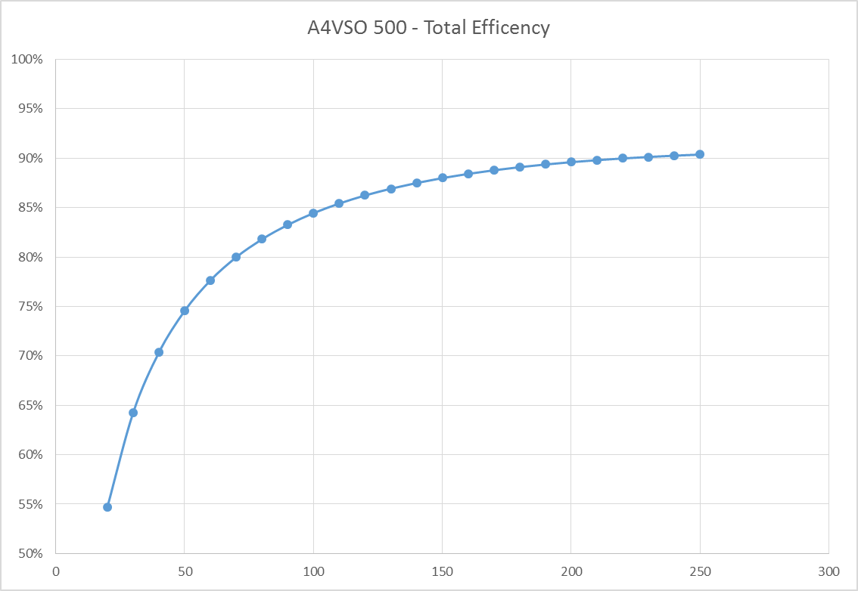
Hydrostatic Drivetrain Efficiency
A4 Motor Efficiency
Company Proprietary

Slide 4
Hagglunds Recommended
65 Cst in Pump
VG 68 - Current Life Calcs
45 Cst in Pump
Published Eff. Values
35 Cst in Pump
Estimated Oil Temperature

