Slide 1
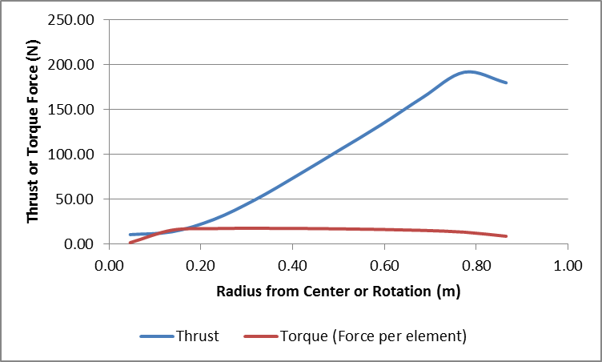
Scaled Blade Design – Stress Analysis
Updated Stress Analysis was run with extreme loads
Max Torque: TSR=6 79.32 RPM Non-3D Corrected
Max Thrust: TSR=15 198.32 RPM Runaway Rotor

Slide 2
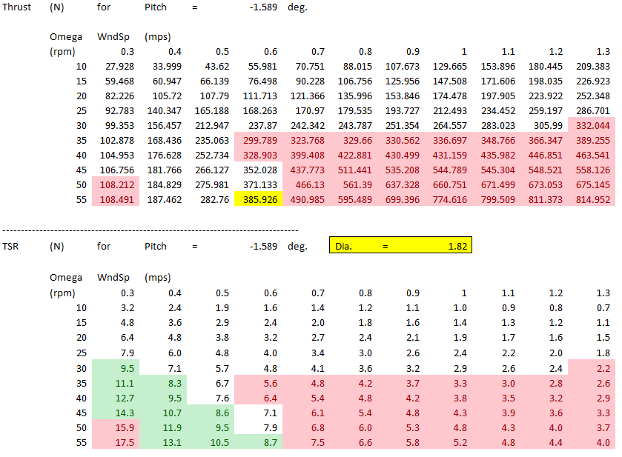
Scaled Blade Design – Stress Analysis
Extreme Loads considered are conservative ~ 78% reduction due to test case adjustments
Red:
Above max torque or below 0 torque
Green:
Above design TSR
Yellow:
Max Thrust within constraints
Nominal speed and TSR testing (1.6m/s, TSR=8) possible for froude scale up to 1/8.2 (250kW nameplate)
High speed testing at nominal TSR (2.2m/s, TSR=8) possible for froude scale up to 1/11 (500kW nameplate)
Runaway rotor testing (TSR=15) possible at nominal speed (1.6m/s) for froude scale up to 1/19.2 (1500kW nameplate)

Slide 3
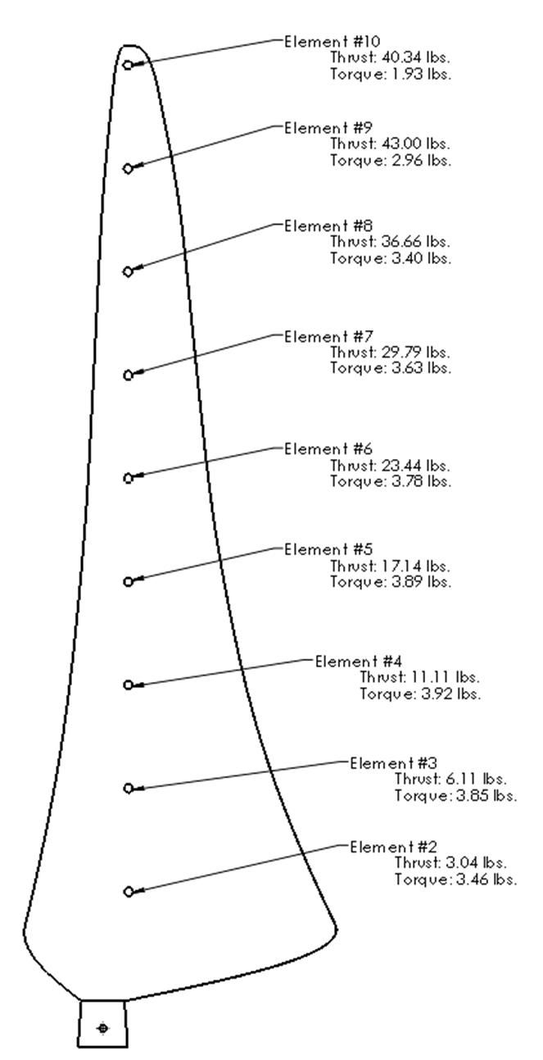
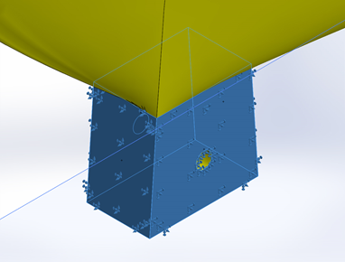
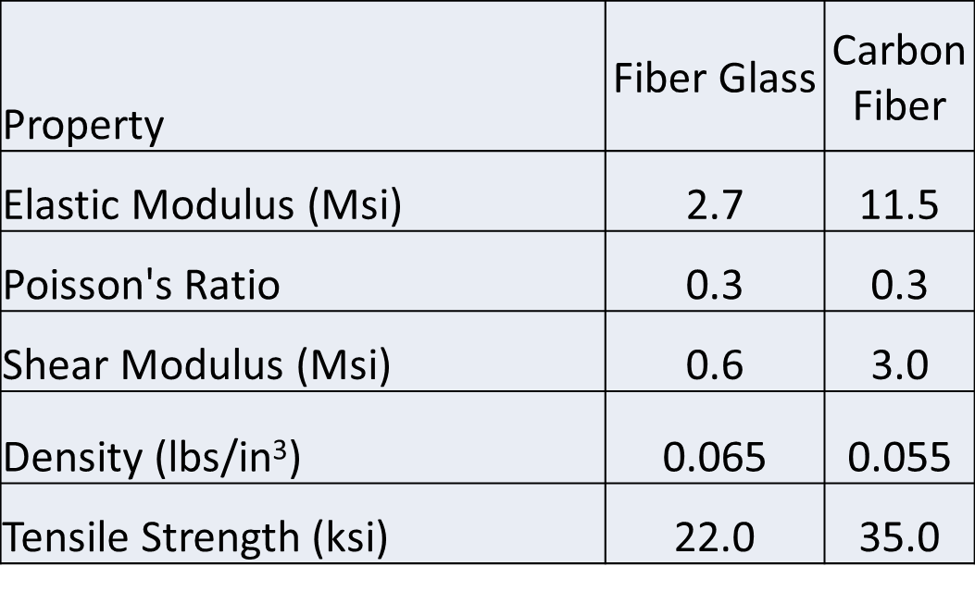
Scaled Blade Design – Stress Analysis
Updated Stress Analysis was run with extreme loads
Spud constrained on four sides

Slide 4
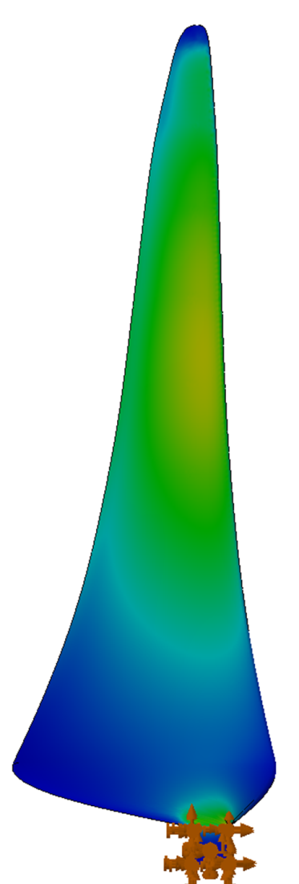
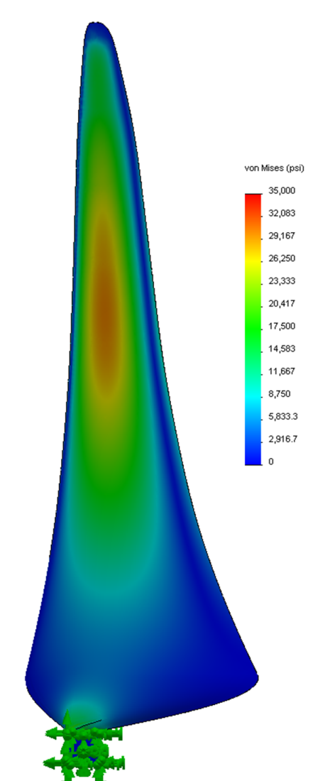
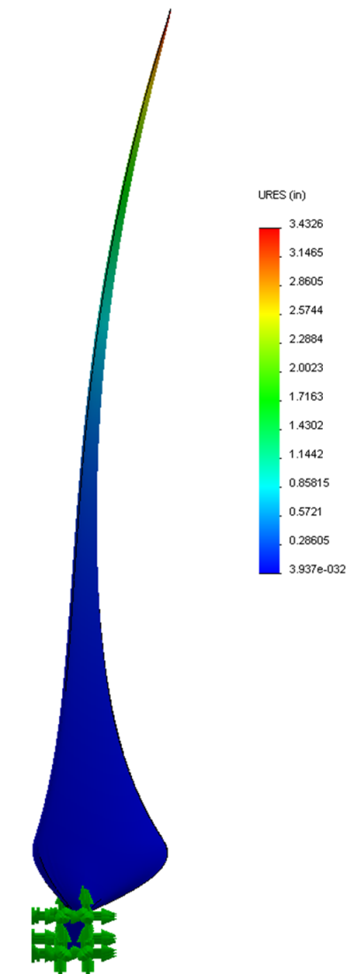
Scaled Blade Design – Stress Analysis
Carbon Compression Molded Blade Results
Stress Factor of Safety
1.15
Max Deflection:
86mm

Slide 5
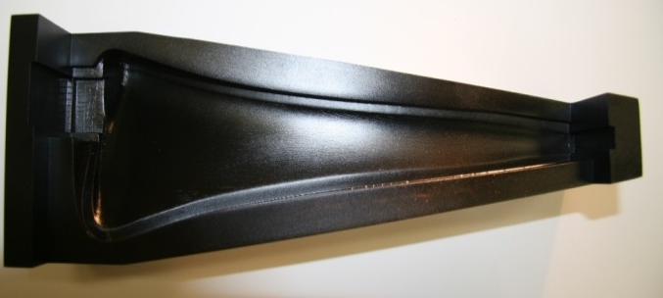
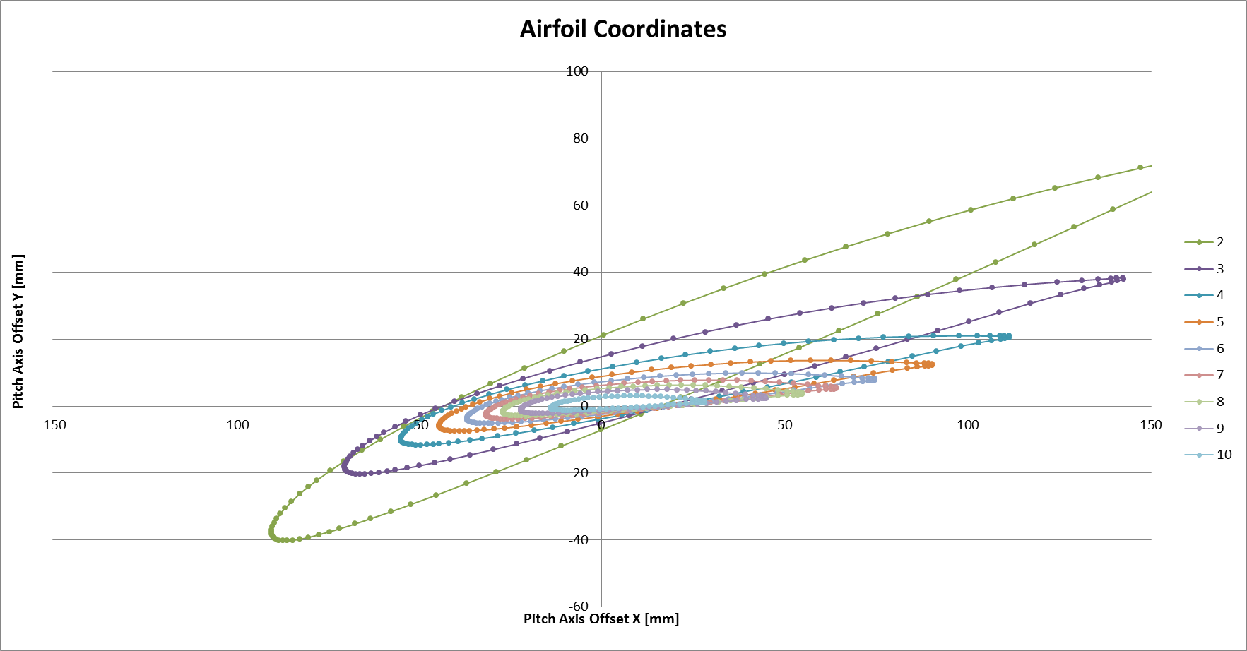
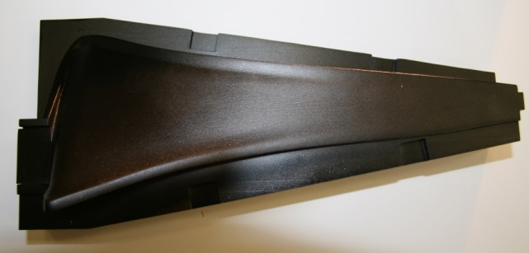
Scaled Blade Design – Loft and Tooling Progress
Loft root design was updated to ease manufacturing
Scale SLA tooling was successfully trialed at NSWC
Root “Spud” was aligned with innermost section

Slide 6
Scaled Rotor Design –Hub Progress
The Hub design has been updated to accommodate Spud
SLA Inserts
Aluminum Hub

