Slide 1
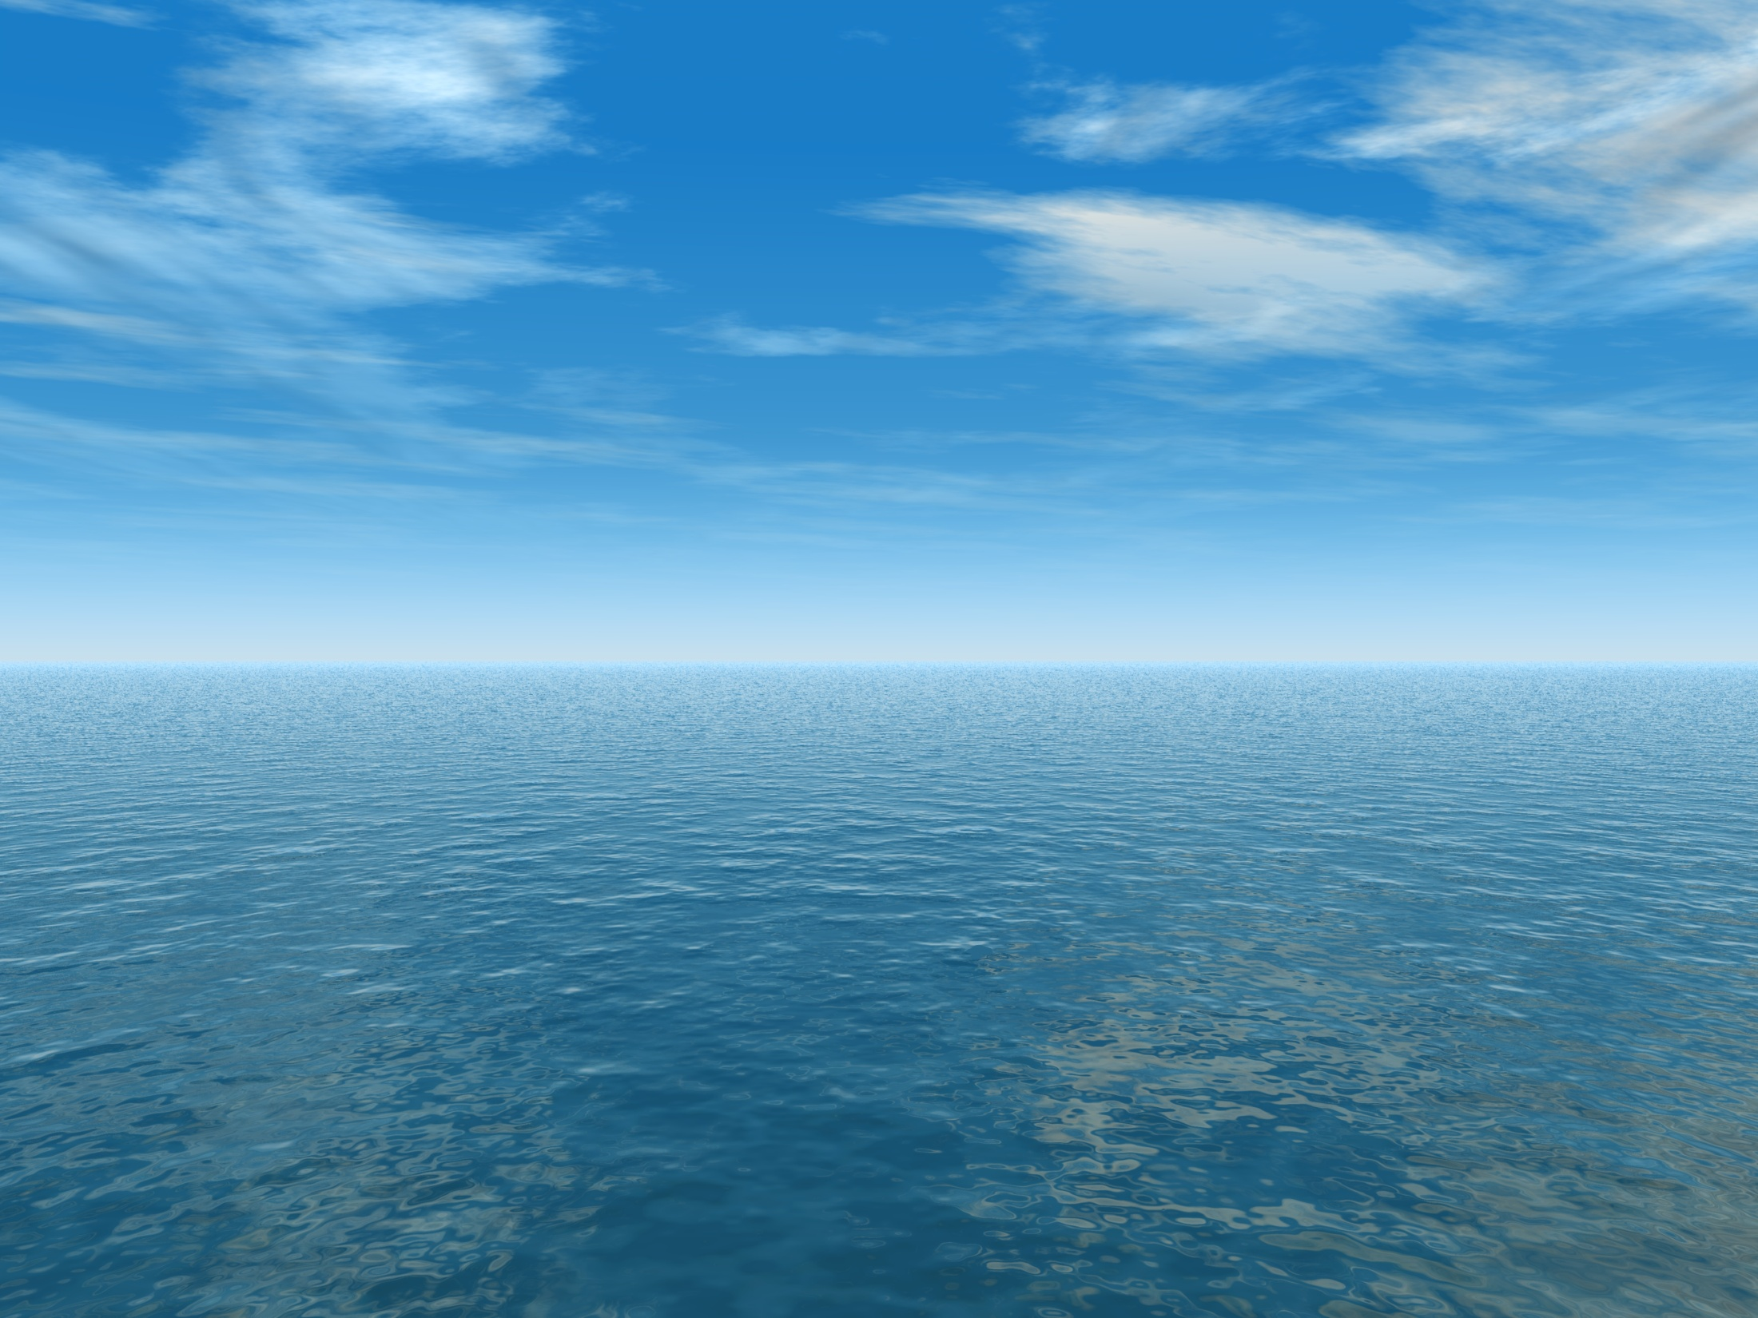


THE AQUANTIS OCEAN-CURRENT TURBINE
RENEWABLE ENERGY FROM MARINE CURRENTS
Scaled Main Wing Design
March 19, 2013
Henry Swales
Dave Coakley, NSWC
Company Confidential and Proprietary

Slide 2
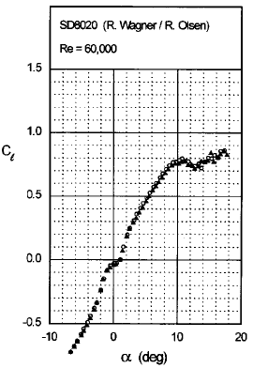
Main Wing Design
Lift Consideration
  Low Re# Non-linear lift slope
Drag Consideration
  A proper design of the wing will include boundary layer development near the trailing edge. This may lead to a small transom or wedge shape at the t.e. which if implemented may improve scaling estimates. –Dr. Coakley

Slide 3
SD 8020
t/c = 10.11%

Slide 4
SD 8020
Non-linearity in lift eliminated by adequate boundary layer trip.

Slide 5
Comparison to Full-Scale
Froude scale chord to attain reasonable Cl scaling.
Verify size and pitch for passive depth control.
Drag and wake will be greater than intended.

