Slide 1
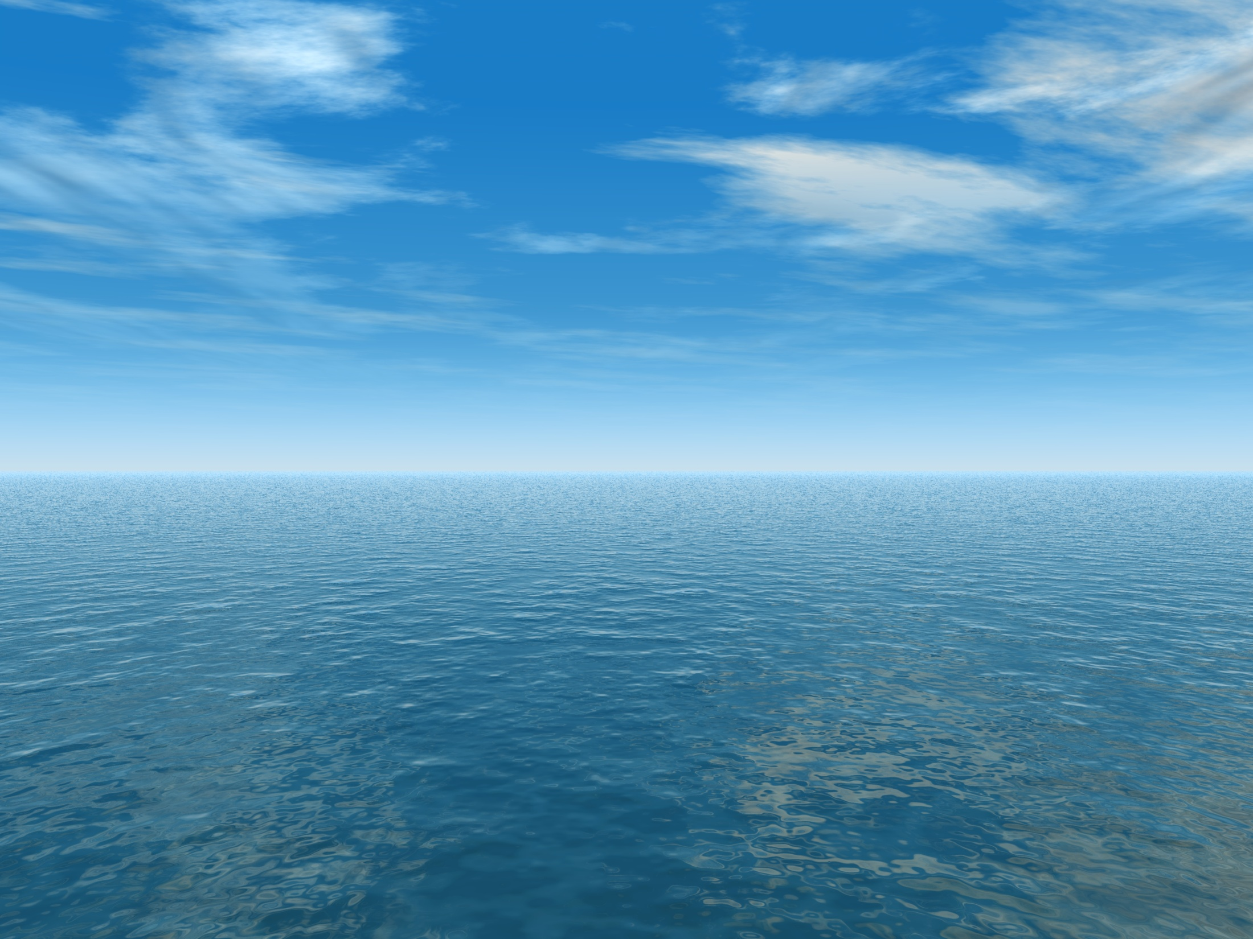


THE AQUANTIS OCEAN-CURRENT TURBINE
RENEWABLE ENERGY FROM MARINE CURRENTS
C-Plane Tow Tank Model Configuration
September 26, 2013
Henry Swales
Ole Kils
Company Confidential and Proprietary

Slide 2
Design Drivers
Goals & Approaches:
Maximize vertical separation of CG & CB
  Place Structural Mass Low
    Keep wake out of alignment with rotor radial directions
  Place Buoyancy High
Minimize wake into the rotor - with and without fairings
  Concentrate upstream structures within 25% blade span where possible
  Move structural members as far forward as possible
    Maximize wake recovery
    Move CG forward to align with CB – eliminate tail cone
Connect all moorings & cables to transverse structure
  Isolate loads measurements at nacelle connection
Provide independent adjustability of CG and CB locations without impacting net buoyancy
Minimize structural mass of buoyant elements
  Cylindrical pressure vessels have more crush resistance than flat fairings (less ribs & structural material required)

Slide 3
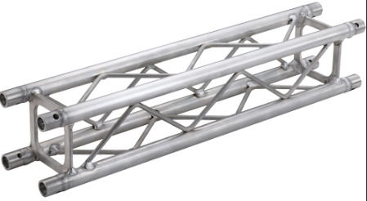
Transverse Structure Type
6061 Aluminum Pipe Transverse Structure: 16.21 lbf
  Including load cells, not including mooring brackets
  Easy Mooring Bracket & Fairing attachment and adjustment.
  2.02m, 44.45mm OD, 25.4mm ID
Optimized Oval Tube (Scaled Steel Weldment): 15.81 lbf
  Wall thickness optimized for stress. Buckling not analyzed.
  2.02m x 160mm x 40mm
Off-the-shelf Aluminum Mini-Truss: 20.00 lbf
  2m x 100mm x 100mm

Slide 4
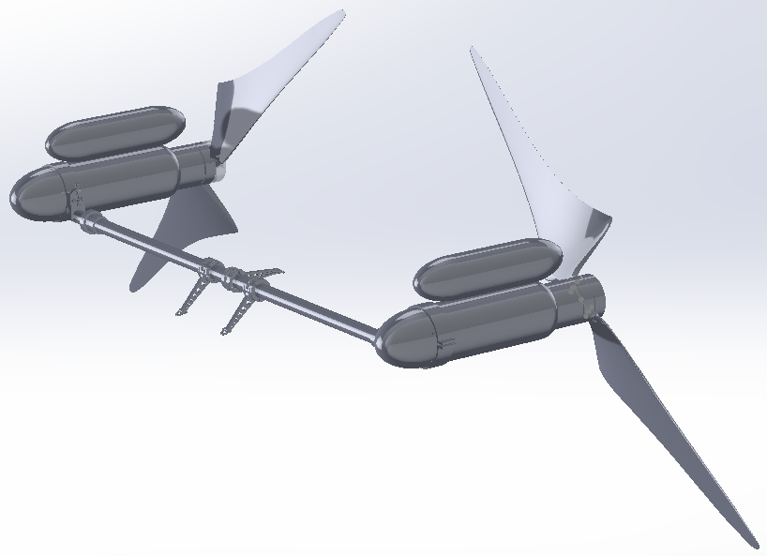
Model Configuration

