Slide 1
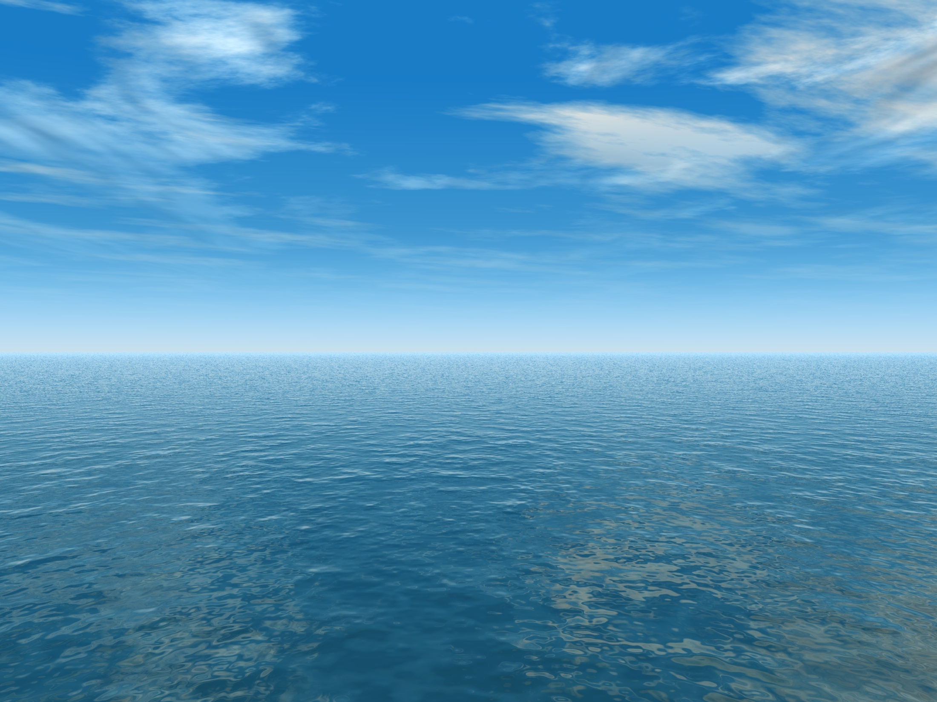


THE AQUANTIS OCEAN-CURRENT TURBINE
RENEWABLE ENERGY FROM MARINE CURRENTS
Aquantis Overview
Alex Fleming, Dehlsen Associates, LLC
Dr. William Zierke, ARL Penn State
Department of Energy (DOE)
Washington, D.C.
February 2, 2012
Company Confidential and Proprietary

Slide 2
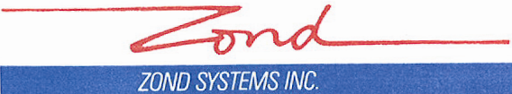

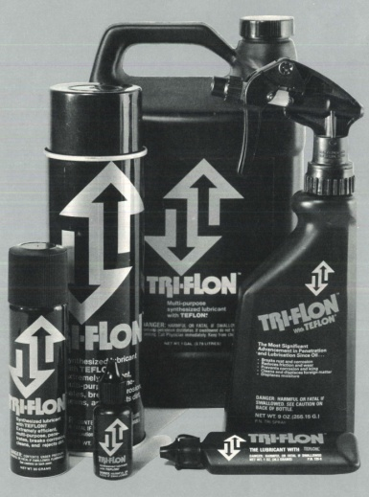
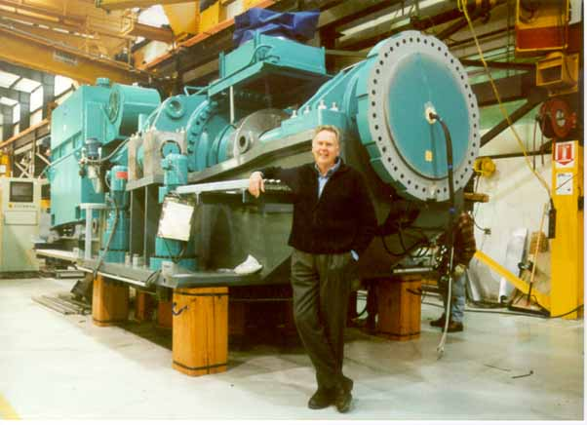
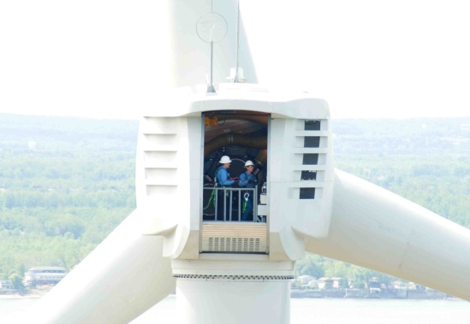
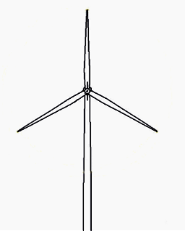
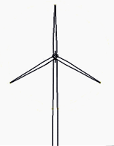

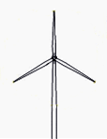



Legacy of Technology and Innovation
Triflon 1975 - 1980
Zond 1980 - 2000
Clipper 2001 - 2010
®
Acquired by Sherman Williams
Rotor Capacity
40m
550kW
50m
750kW
70m
1.5MW
96m
2.5MW
Acquired By:

Slide 3

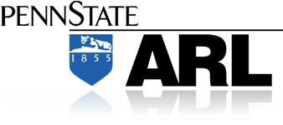




Team
Jim Dehlsen : Innovation and System Architect
Brent Dehlsen: CEO
Mauricio Quintana : President Aquantis
Alex Fleming : VP of Engineering
Dr. Coakley : Stability
Dr. Coffin: Composites
Rich Banko : PI W&T
Al Schwartz : Rotor Codes
Dr. Zierke : PI Hydrodynamics
Dr. Willits: Performance
Dr. Koudela: Marine Composites
Mike Beam : Bearings and Seals
Dr. Dreyer : CFD Steady/Unsteady
VP Dave Hull
Peter Erhart
Nathan Godiska
Andy Fellner
sfsi
Tom Hudon
Gus Ruetnik
Ed Hahlbeck
Tom Foley
Lars Andren
Bo Hornsten
Dr. Erdman
All Key Personnel Rarified Skills > 20 Years

Slide 4
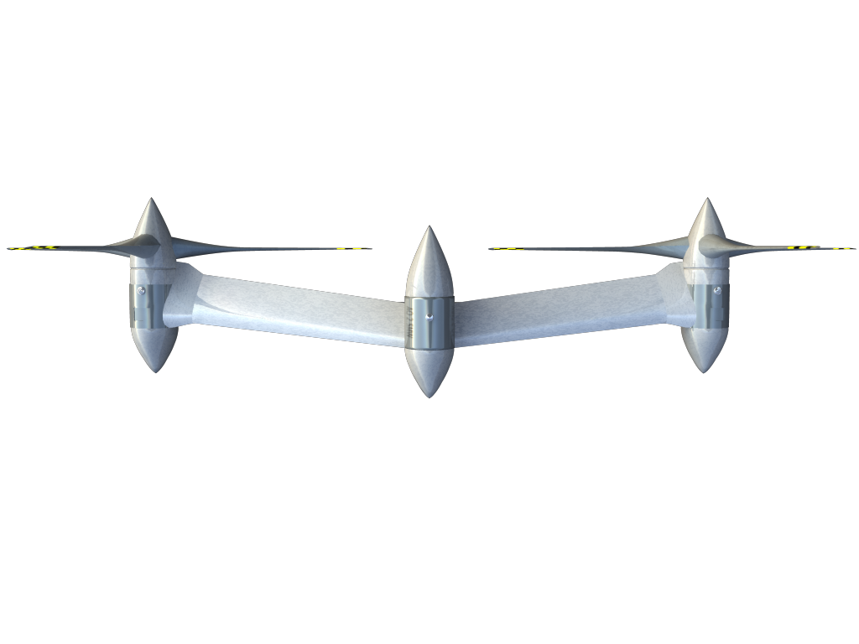
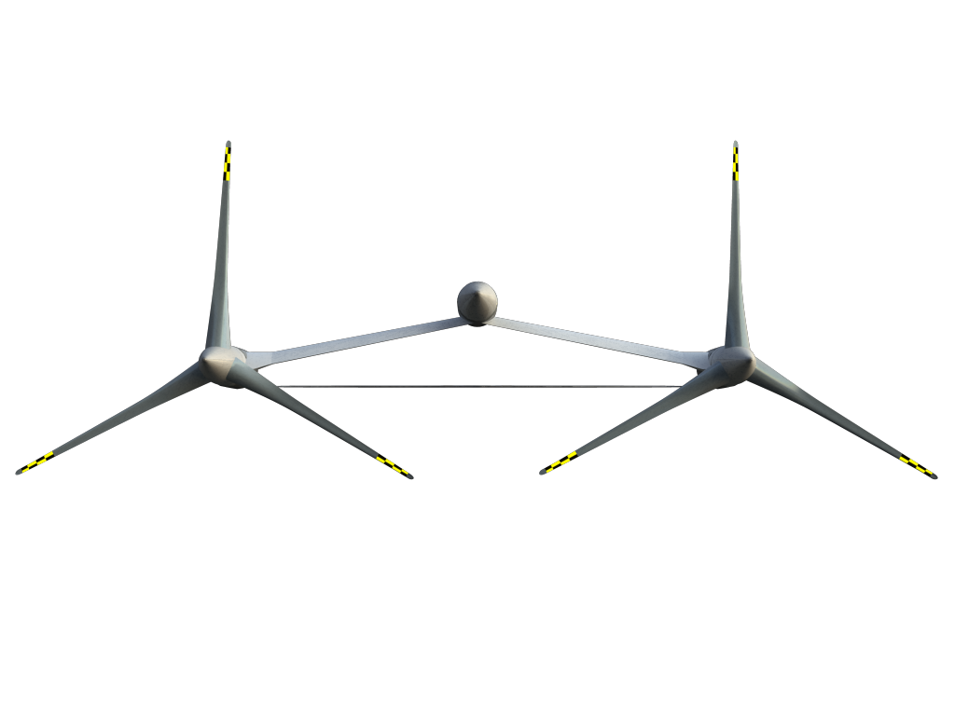
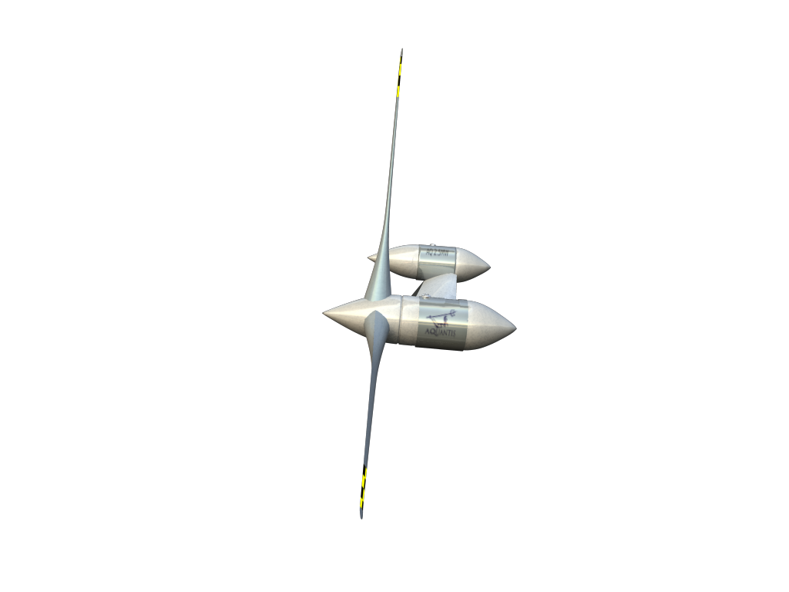
Legacy Current Plane (C-Plane)
Advanced Design Not Shown
Electric Generation
Nacelle Length: 13.9 m
Nacelle Vessel Diameter: 3.8 m
Weight: 385 Tons
Powertrain: 1.3 MW each
Power Collection: Medium Voltage
LOA ( rotor tip-to-tip) : 87.4 m
Rotor diameter: 40.6 m
Power : 2.6 MW

Slide 5
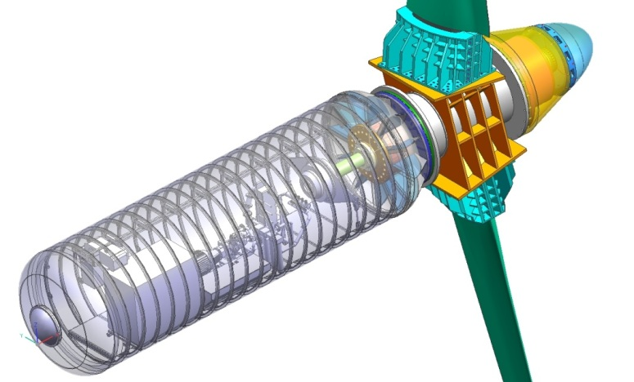
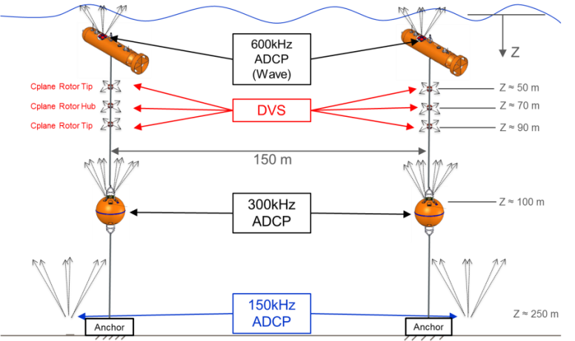
Aquantis Preliminary Design Review
Platform evolution:
  Multi- MW Platform
  800 kW rated power per turbine
  Variable-speed/Fixed-pitch turbine
  Hydraulic drive: LSHT/HMG-CS
  Carbon-composite blade spar with tang-in-socket joint
  Factor of safety (FOS) = 3
  COTS equipment

Slide 6
Aquantis Preliminary Design Review
Update:
  October 18-19, 2011
  COE: 17.7 Cents/ kWh: FOS=3
  Suboptimal COTS Equipment
  Cost Waterfall: 10.4 cents/kWh
  DOE peer Review: November 1, 2011
  Resource assessment: May 15, 2012
  1/20th-scale towing-tank: June15, 2012
  Critical-element composite-material testing: August 30, 2012
  Tentative: Full-scale drivetrain testing

Slide 7
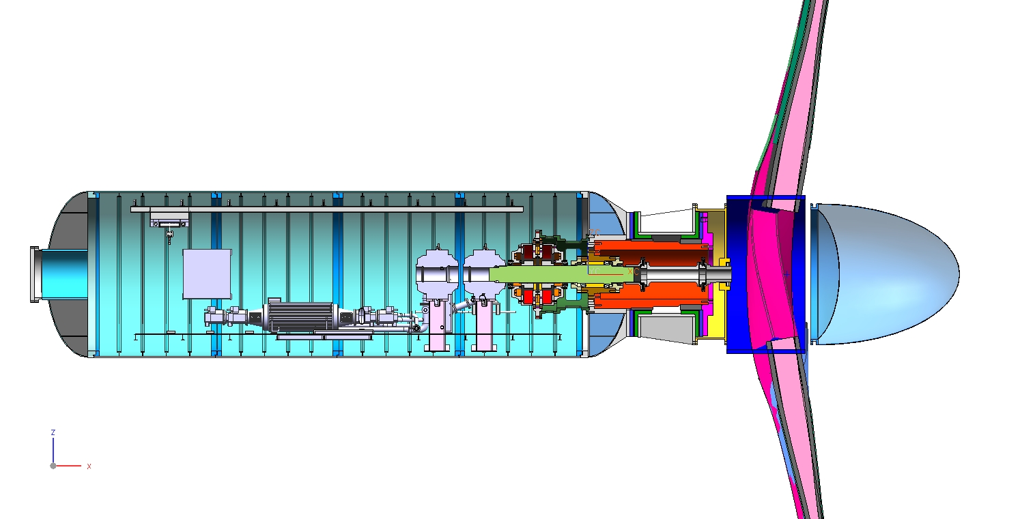
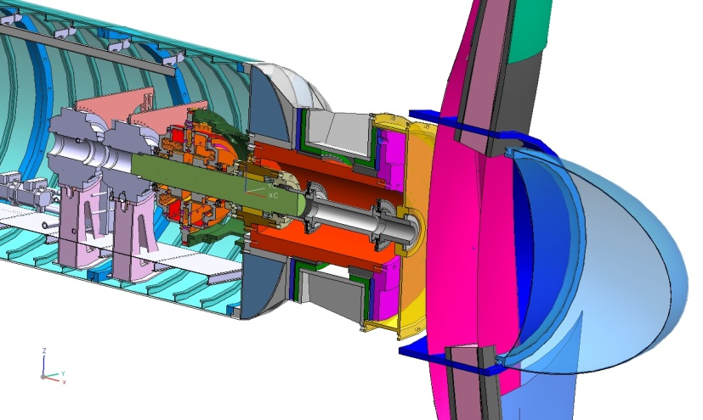
Increased Power Output (1.0 MW)
CBM4000
Internal Brake
CBM4000
HMG
Spud Concept
Drive Shaft
Flex Coupling
Duramax
Fluidic Bearing
Buoyant Tailcone

Slide 8
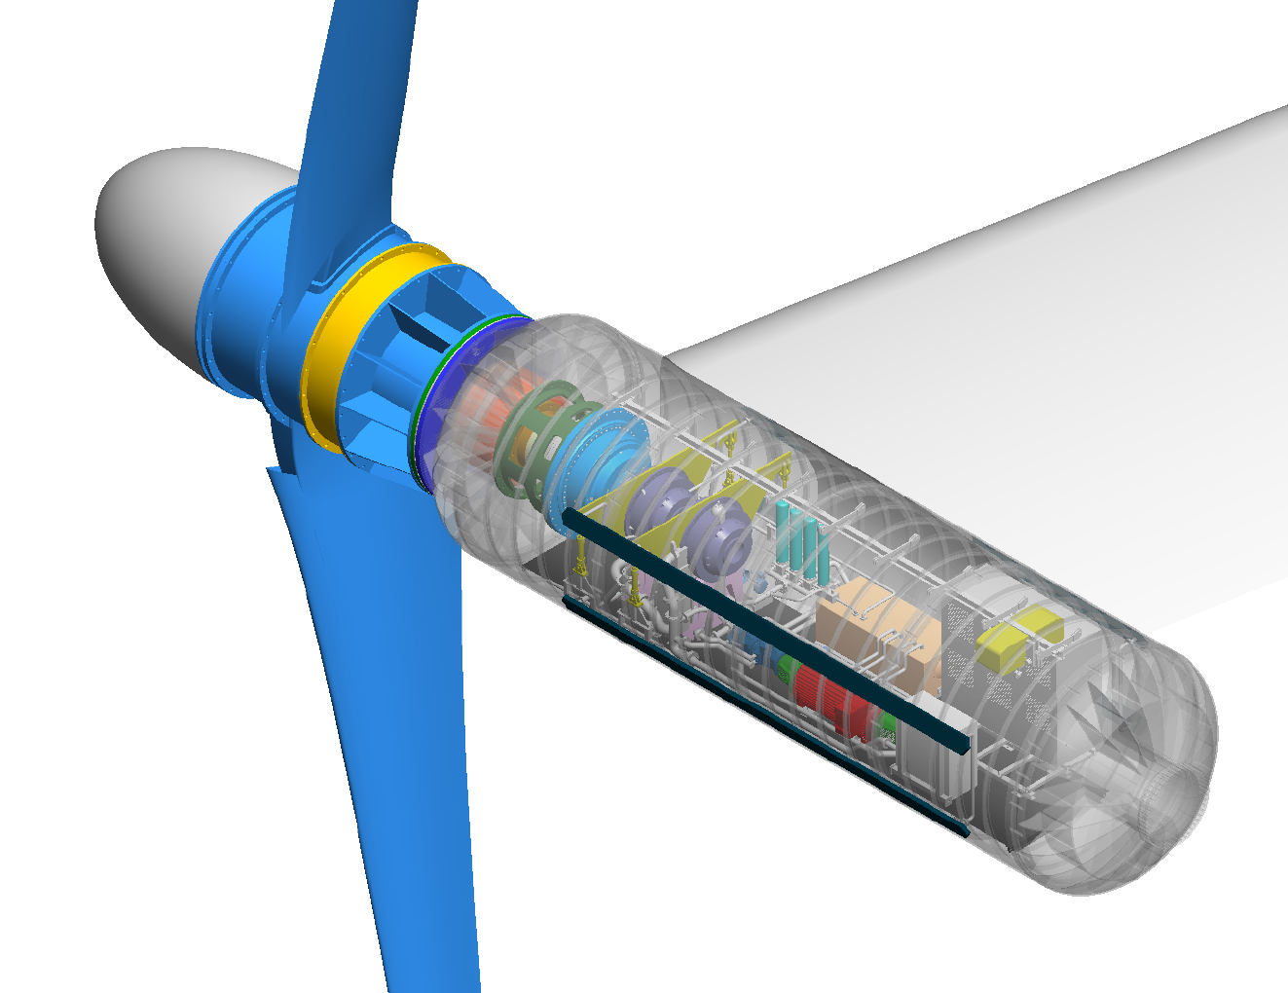
Increased Power Output (1.0 MW)
STRUCTURAL WING
WET ROTOR
ASSEMBLY
TAILCONE
INTERNAL BRAKE
FILTER ASSEMBLY
HYDRAULIC RESERVOIR
ELECTRICAL TRANSFORMER
BLADE SET
HYDRAULIC PUMPS x2
OVERHEAD CRANE
HYDRAULIC MOTOR GENERATOR (HMG)
HEAT EXCHANGER
ELECTRICAL CABINET
ACCESS HATCH

Slide 9
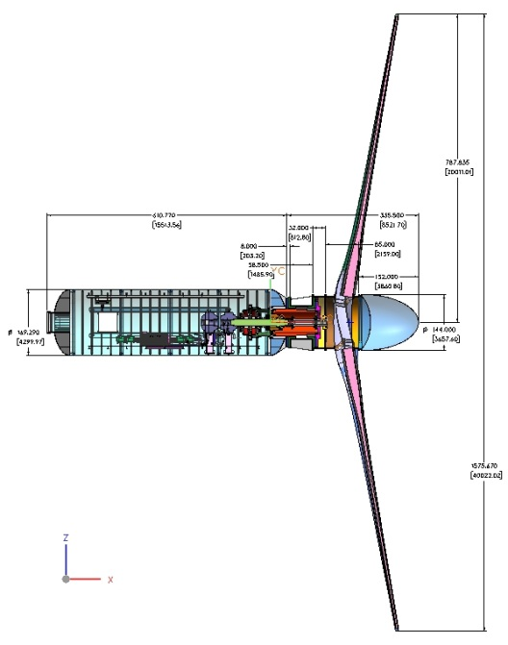
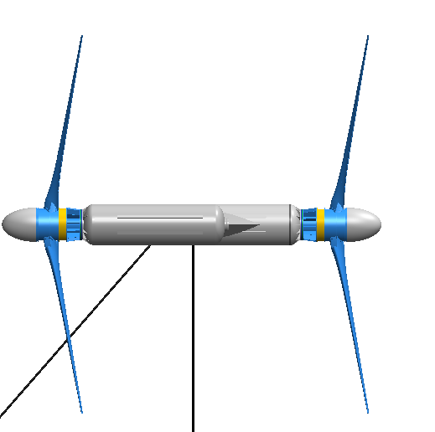
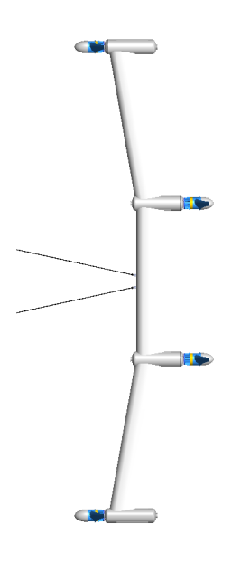
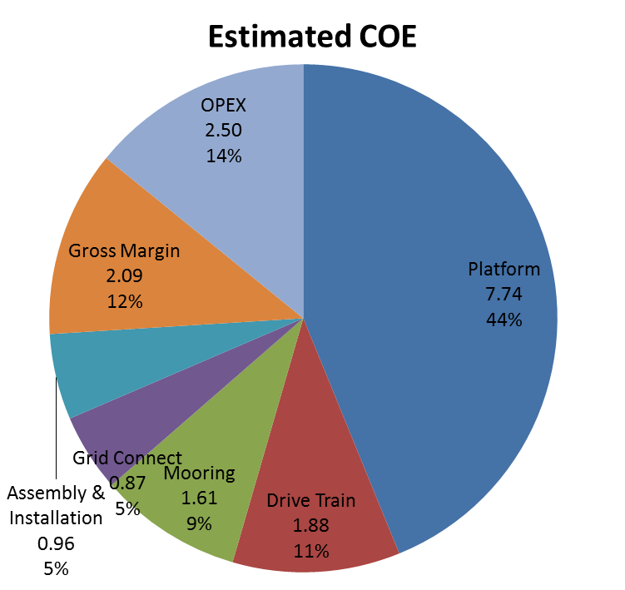
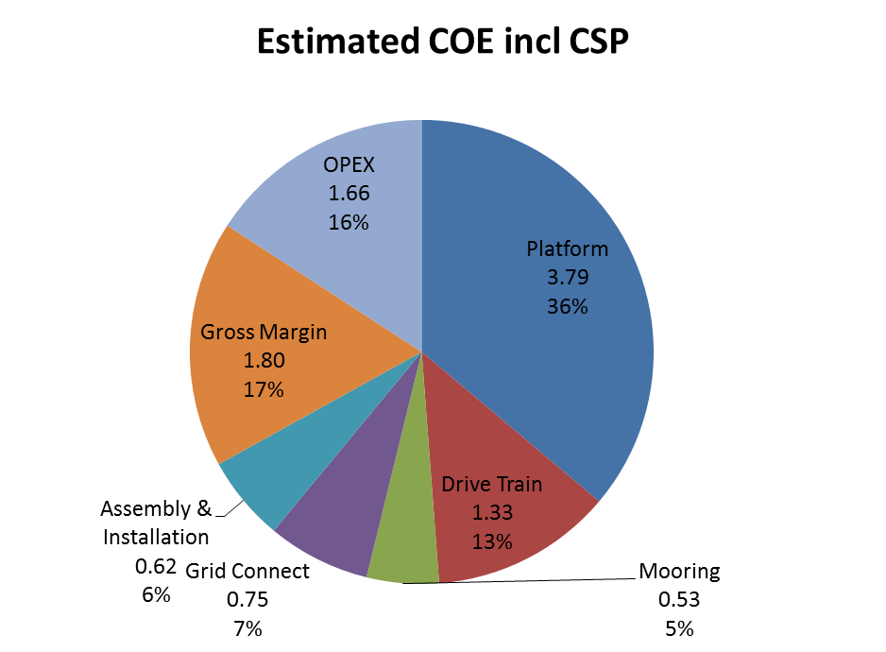
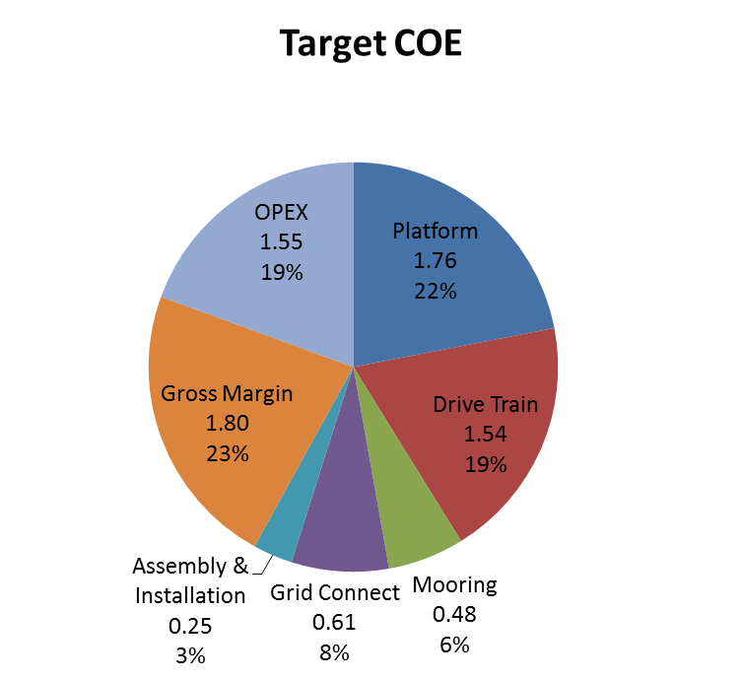
Cost of Energy (COE) Status
Preliminary Design Review
Current
Target
17.7 cents/kWh
10.4 cents/kWh
8.0 cents/kWh

Slide 10
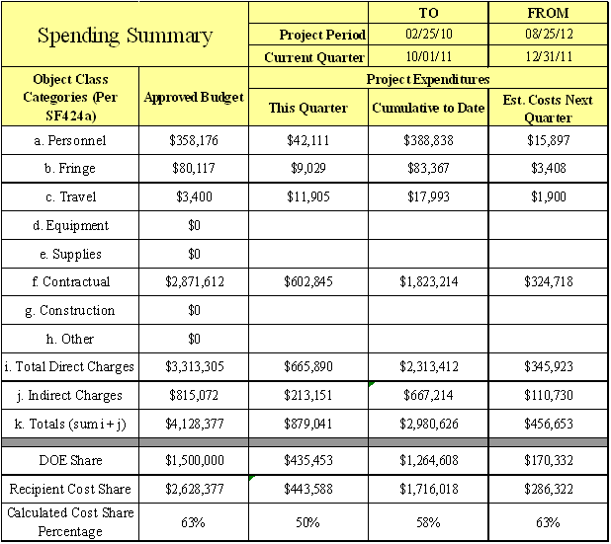
Financial Overview (AWP)

Slide 11
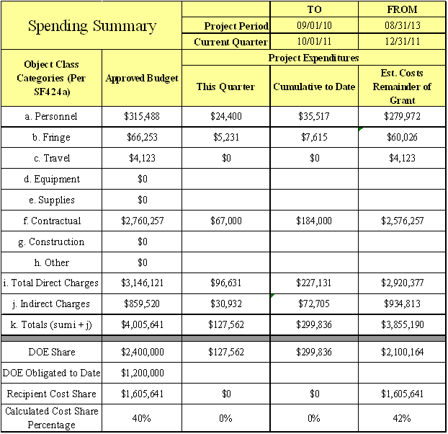
Financial Overview (MHK)

Slide 12
Financial Overview: Spend Plan

Slide 13
Schedule/Budget
2010
2011
2012
2013
2014
2015
Q4
Q1
Q2
Q3
Q4
Q1
Q2
Q3
Q4
Q1
Q2
Q3
Q4
Conceptual
Design (5/5/11)
TR4
TR5
TR5
TR6
TR7
TR8
TR9
TR4
TR5
PDR
(10/18/11)
CDR
(10/15/12)
(x/x/x)
Detailed Design
Build 1:20 model
Build Full Scale Turbine
Finalize
Configuration
(09/15/11)
Tow Tank
Test of 1:20 scale
(03/15/12)
At sea
Test of 1/20 scale
(2/21/13)
At sea
full scale test
(3/15/14)
Full Scale Drive Train Test
(11/15/12)
$2.3Million Spent of $8.15 Million Aquantis Budget

Slide 14
Outline of Technical Presentation
Background
  Business case
  Existing resource data
  Requirements
Conceptual design
  Turbine
  Drivetrain
  Platform
  Mooring and Anchoring
  Key decisions
Preliminary design
  Turbine
  Drivetrain
  Platform
  Mooring and Anchoring
  Grid Connection
  Cost of Energy
  Key decisions
Updated preliminary design
  Turbine
  Cost of Energy
Next steps

Slide 15
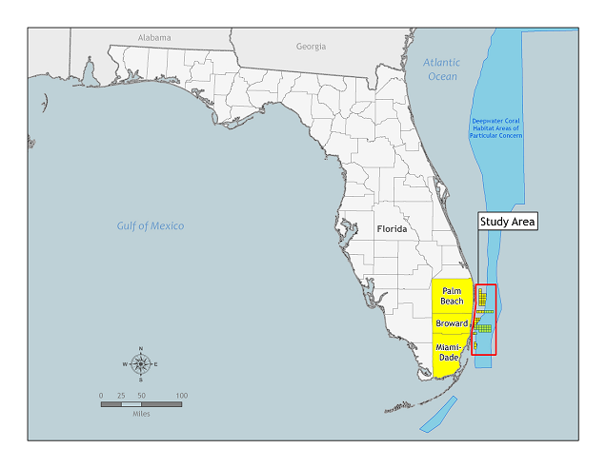
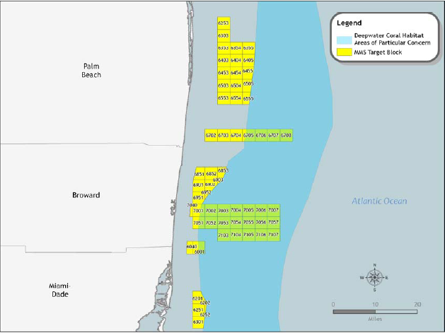
Aquantis
Develop Technology to Harness the Energy Resource Available in the Gulf Stream
Scoping Study of the Gulf Stream performed by NOVA University’s Coral Research Institute
  Potential of ~25 GW
  5 GW immediately addressable
Current circulation and climate change study by the University of Delaware
  Confirmed size of energy resource
  “no significant impact on circulation”

Slide 16
Business Case
Florida’s electrical power generation
  Primarily natural gas
    Some coal, oil, and nuclear power
  Approximately 2% renewable power sources
    Mostly biomass and solid waste
    Little hydro, solar, and virtually no wind installations
  Demand expected to continue grow at an accelerated pace and so will electricity prices
  Need to hedge the risk of gas prices by diversifying its power generation portfolio
  The Gulf Stream is unique to Florida
Aquantis Powerplant Can Help Better Position Florida for Growth in the Future

Slide 17
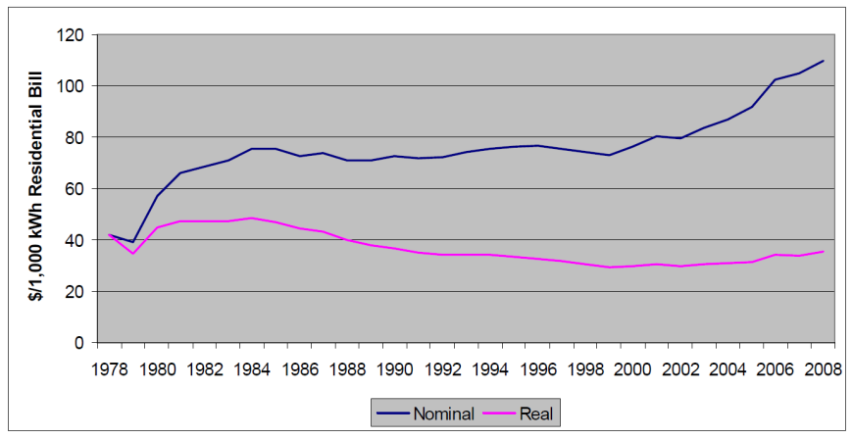
Business Case
Florida Installed Capacity as of 2009
Biomass 0.70 %
Solid Waste 0.70%
Waste Heat 0.50%
Hydro 0.10%
Solar 0.10%
Other
10.7%
Nuclear
6.60%
Oil 10.7%
Coal 19.5%
Total: 59.7 GW
Renew.: 1.2 GW
Natural Gas 44.1%
Florida 2019 Capacity Projection
Florida Electricity Pricing Trends1978-2008
Biomass 0.90 %
Solid Waste 0.10%
Waste Heat 0.80%
Hydro 0.10%
Solar 0.10%
Other
7.7%
Oil 12.2%
Nuclear
8.8%
Coal 18.2%
Total: 63.7 GW
Renew.: 1.9 GW
Natural Gas 50.1%

Slide 18
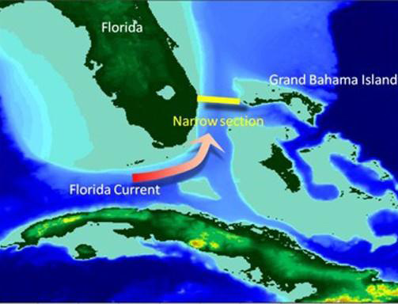
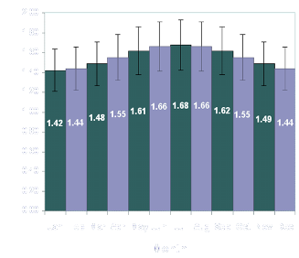
Existing Gulf-Stream Resource Data
Florida Current resource measurements acquired by Florida Atlantic University (FAU)
  Masters Thesis – Raye [2002]
    19 months of data
  Measured mean flow
    Single site
    Acoustic Doppler Current Profiler (ADCP)
    Three components of velocity
    Entire water column
    Low-frequency data
  Recent additional ADCP data
Further analysis by V-Bar
2.00
1.80
1.60
1.40
1.20
1.00
0.80
0.60
0.40
0.20
0.00
Velocity (m/s)
Jan Feb Mar Apr May June July Aug Sep Oct Nov Dec

Slide 19
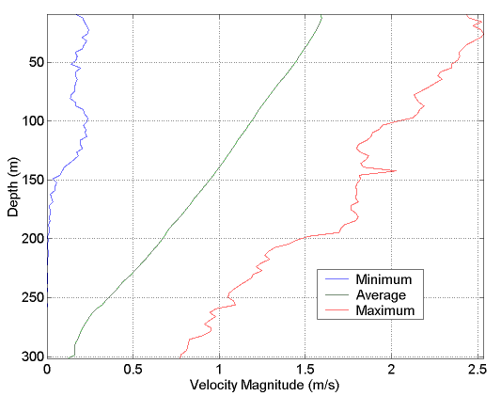
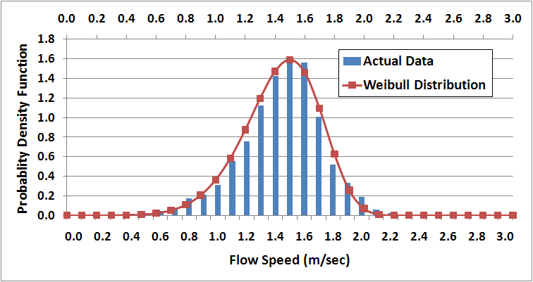
Existing Gulf-Stream Resource Data
FAU
Less vertical shear than in wind
More consistent flow than either in wind or tidal currents
Larger density fluid (~800 x) than used in wind turbines
  More power
  Higher loads (structural issues)
Key powering parameters:
V-Bar
Depth = 66.2 meters
Power Coefficient
Annual Energy Production
Capacity Factor
Weibull Distribution

Slide 20
Current Aquantis Project
Current project:
  Start: September 2010
  Conceptual Design Review: May 3-4, 2011
  Preliminary Design Review: October 18-19, 2011
Team:
  Ecomerit Technologies
  ARL Penn State
  NSWC
    Carderock
    South Florida Ocean Measurement Facility (SFOMF)
  PCCI
  BEW Engineering
  Straight Forward Systems
  Powertrain Engineers
  Bosch Rexroth and Hägglands

Slide 21
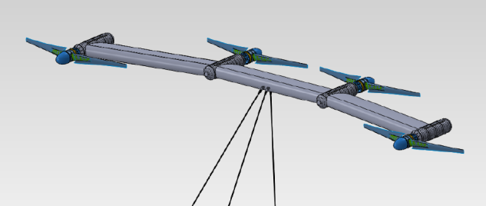
System Concurrent Engineering
Resource Assessment
Mean Flow
Turbulent Structures
Extreme-Load Conditions
Sea-Bottom Conditions
Turbine Design
Hydrodynamic Blade Design
Hydrodynamic Load Assessment
Blade-Manufacturing Design
Blade-to-Nacelle Attachments
Structural Assessment
Shaft, Bearings, and Seals
Drivetrain
Turbine Input
Drivetrain Components
Power Electronics
Power Loss Estimates
Connection to the Grid
Cost of Energy
Component Costs
Manufacturing Costs
Maintenance Costs
System Energy Output
Energy Prices
System Design
Nacelle Designs
Wing Designs
Stability Surfaces
Attachments
Pressure Vessels
System Operation
Fabrication and Assembly
Installation
Operation
Maintenance
Emergency Operation
Stability, Mooring, and Anchoring
Weight and Buoyancy
Hydrodynamic Forces and Moments
System Stability Modeling
Mooring Lines and Attachments
Anchoring
Configuration Control
Component Geometry
CAD Modeling

Slide 22
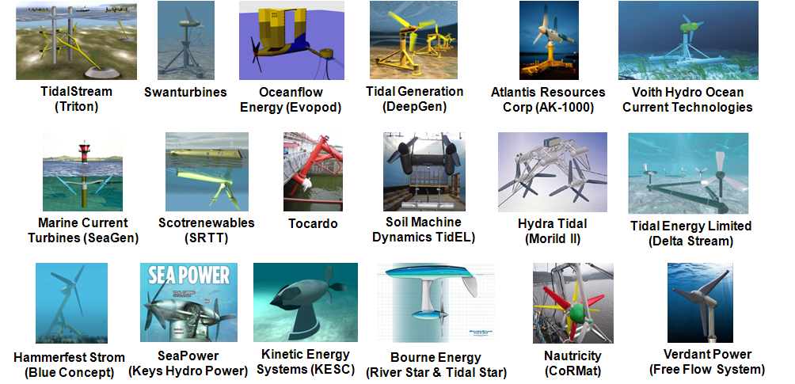
Other Marine Hydrokinetic Turbines
Numerous concepts for open, horizontal-axis marine hydrokinetic turbines for tidal and river currents
Several companies have at least put prototypes in the water
  United Kingdom (9), Germany (2), Norway (2), United States (2), and The Netherlands (1)
Two major blade failures:
  Higher than expected currents
  Difficulty in manufacturing composite blades
  Difficulty in attaching composite blades to a metal hub

Slide 23
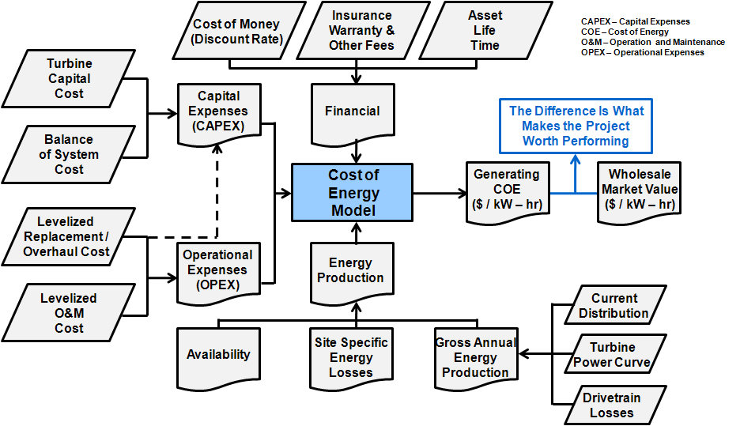
Cost-of-Energy (COE) Model

Slide 24
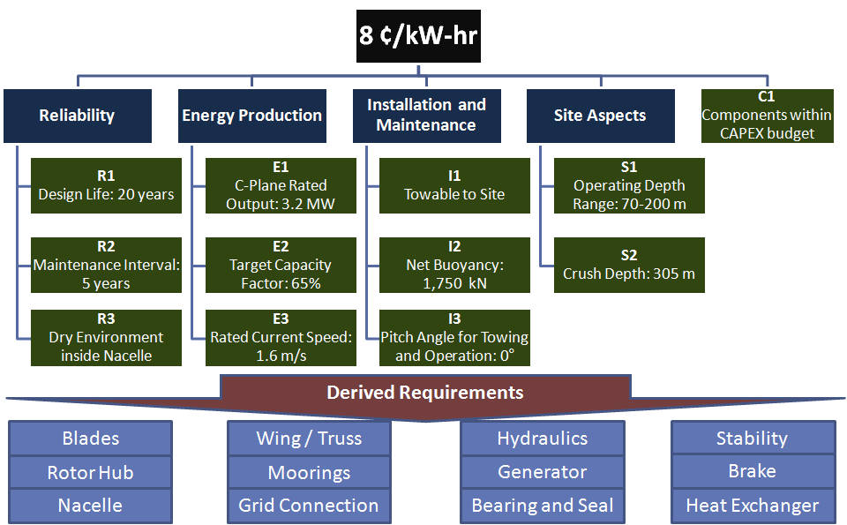
Requirements
Ecomerit Technologies has developed and is evolving both the top-level system requirements and the subsystem requirements

Slide 25
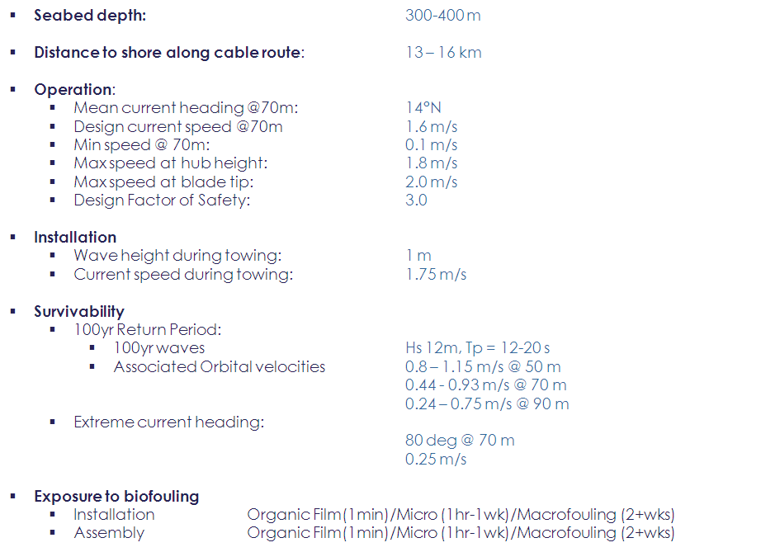
Environmental Conditions and Loads
Current | Mean Speed
Depth (m) | (mps)
56.4 | 1.48
66.2 | 1.44
75.9 | 1.40
85.7 | 1.35
95.4 | 1.31
105.2 | 1.27
114.9 | 1.23
*Taken from V-Bar study on 2000-2002 Data Set

Slide 26
Derived Factors of Safety
Subsystem | Current Factor of Safety | Reasoning
Moorings | Intact: FoS =3 @1.8 m/s * Broken line: 2.25 @ 1.8 m/s * | Broken Line determined from ratio of API intact (1.67) to FoS of 3
Blades | FoS = 3 @ 2 m/s * | Conservative approach due to history of blade failures; 2m/s based on blade tip speed
Wing/Truss | FoS = 3 @ 1.8 m/s * | Conservative approach resulting from dynamic loading not being fully understood
Nacelles | FoS =1.5 @ crush depth * | Dynamic loading will have to be considered
* Factors of safety are explained further in subsystem presentations

Slide 27
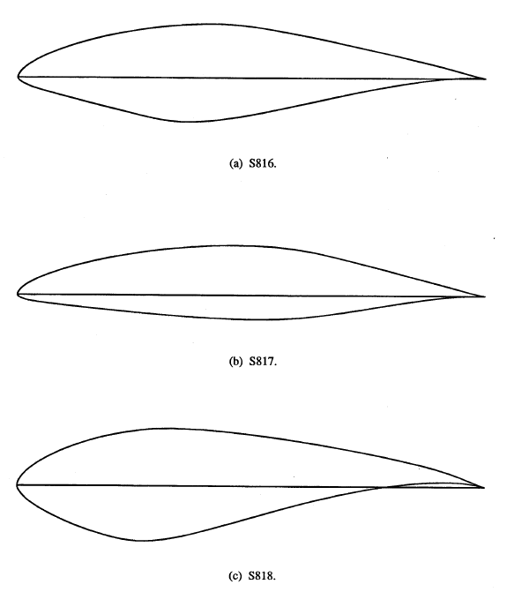
Turbine Conceptual Design Study
Investigation of hydrofoils for blade sections
Parametric design study varying…
  Rated power
    500 kW → 1,300 kW
  Tip diameter
    25 meters → 40 meters
  Blade number
    2, 3, & 4
  Root chord → structural integrity
  Variable-speed & fixed-speed designs
Primary tools:
  NREL Codes: HARP_Opt, WT_Perf
  XFOIL
Blade Tip
S817
Blade Mid-span
S816
Blade Root
S818
Somers [2004]

Slide 28
Design Codes
National Renewable Energy Laboratory (NREL) Codes
  WT_Perf
    Blade-element-momentum (BEM) performance code for predicting the rotor performance
  HARP_Opt
    Horizontal-Axis Rotor Performance Optimization (HARP_Opt)
    Numerous design evaluated using WT_Per
    Genetic algorithm optimizes designs for turbine performance
Sizing and blade-stacking codes written by ARL Penn State
XFOIL
  Viscous foil analysis code developed at MIT
Computer-aided design (CAD) software
CFD (ARL Penn State in-house code)

Slide 29
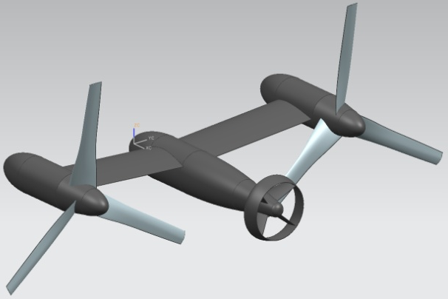
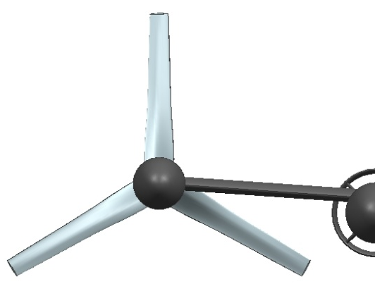

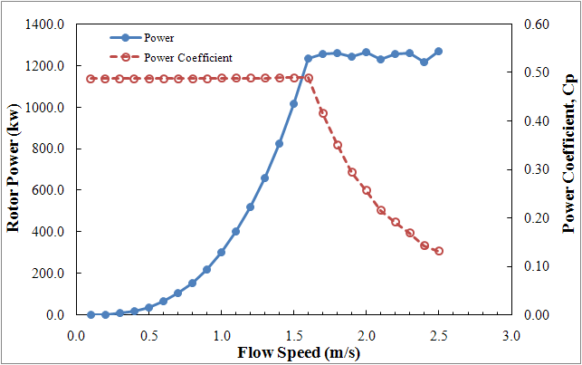
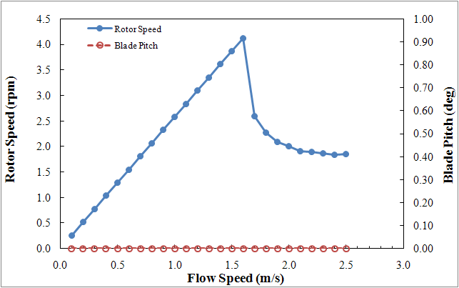
Early Conceptual Turbine Design
3-bladed, ~1,300-kW turbine:
“Fly” Through the Gulf Stream
Mechanical Braking and Blade Stall
Variable-Speed Concept
4.1 rpm

Slide 30
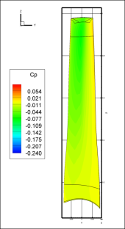
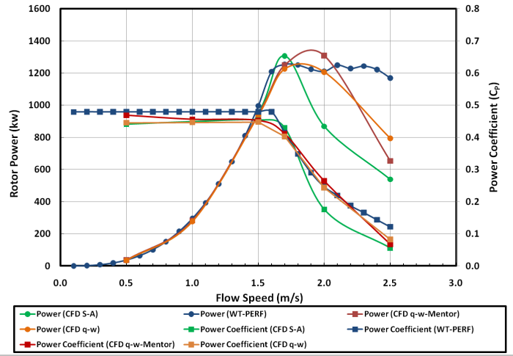
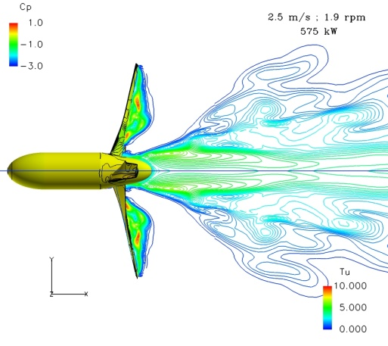
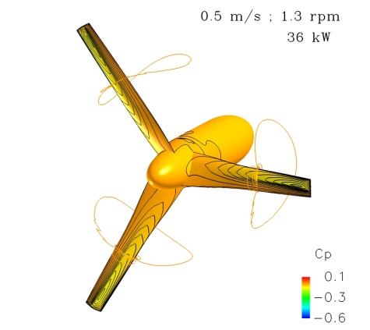
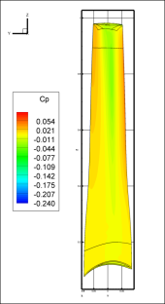
Early Computational Fluid Dynamics
Experience in using CFD for hydrokinetic turbines
  ARL Penn State in-house CFD solver
Three-dimensional, steady, single-blade CFD simulations
  Input to finite-element analysis (FEA) for structural integrity
Suction Surface
Power
Good Comparison with NREL Codes Prior to Stall
Deep Stall
Input to FEA
Pressure Surface

Slide 31
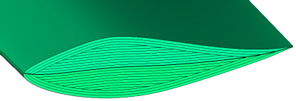
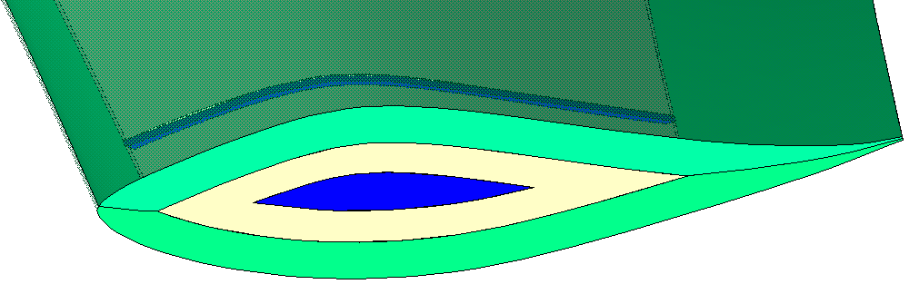
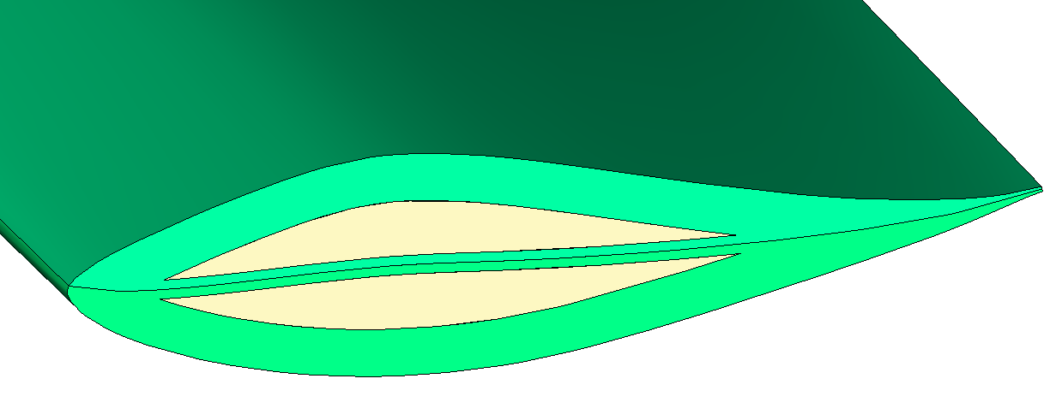




Blade Manufacturing Concepts
Blade Concept 1:
Blade Concept 2:
Blade Concept 3:
Structural
Thick Composite
Thin Hydrodynamic
Composite Blade
Skin with Load
Skin with Load
Sharing Internal
Bearing Internal
Structure
Structure
1A
2A
3
Composite Spar
1B
2B
1C
Steel Spar
3A Steel Fairing
3B Composite Fairing
Foam
2C
1D
Foam-Filed Steel Modules

Slide 32





Blade-to-Nacelle Attachment Concepts
Blade Concept 1:
Blade Concept 2:
Blade Concept 3:
Structural
Thick Composite
Thin Hydrodynamic
Composite Blade
Skin with Load
Skin with Load
Sharing Internal
Bearing Internal
Structure
Structure
Attachment Concept 1:
Attachment Concept 2:
Blade in Pocket
Bolted Attachment
Clamshell with Pins
Blade in Pocket (3)
Bolted Attachment (2)

Slide 33


Drivetrain Concepts
Direct-drive, permanent-magnet generator
  Too large, too heavy, too costly
Two-stage gearbox with either a permanent-magnet generator or an induction generator
Hydrostatic drive
  Use of fluid coupling to reduce the torque, rather than the mechanical coupling of a gearbox
Two-Stage Gearbox, Similar to Current Design for NREL
Hydrostatic Drive

Slide 34


Early Unsteady CFD
Three-dimensional, unsteady CFD similations:
  36 turbine cases (6 conditions @ 6 pitch angles: 0°- 25°)
    Input to NSWC Carderock for stability calculations
      Hydrodynamic coefficients, comparison to FLIGHTLAB
    Input to PCCI for mooring design
  One full system case
Full System
Vortex Shedding
Matrix of Forces and Moments

Slide 35


Early Static-Stability Analysis
Platform concepts
  Nacelle
  Wing
  Horizontal faring
Mean rotor forces and moments from unsteady CFD results
Standard wing forces and moments
Mooring line length and tension
Required platform lift
Required tow-point location
Weights and Buoyancies
Notional Concept
Free-Body Diagram

Slide 36








Mooring and Anchoring Concepts
Possible Mooring Leg Concepts
Possible Anchors (Seabed Dependent)
Gravity
Vertical lift
Driven piles
Suction embedded
Torpedo
Possible Subsea Mooring Tethers and Connectors

Slide 37

Conceptual Design Review: Decisions
Need for better resource measurements
  Mitigates design risk and uncertainty in the structural loads
    Mean velocities and shears:
      Larger depth ranges
      Improved resolution
      Seasonal variability
        Extreme conditions
    Turbulence:
      Intensities
      Structures
    Fluid flow properties
    Particulates and biological life
    Seabed floor assessment
      Selection of anchoring concepts
Image courtesy of RDI (www.rdinstruments.com)

Slide 38
Conceptual Design Review: Decisions
Fixed-pitch blades
  Eliminates mechanical complexity and improves system reliability
    Potentially very high maintenance costs to repair or replace a failed variable pitch mechanism submerged in the ocean
  Produces less power, but not a large disadvantage because of the relatively-constant ocean-current environment

Slide 39

Conceptual Design Review: Decisions
Two-bladed turbine
  Reduces blades costs and complexity
  Simplifies transportation and installation
    Cost savings
  Reduces the maximum efficiency (C_{P})
    3 → 2 blades: ~3-6% decrease in power
  Increases blade loading
    Impact on the structural design
Rohrbach and Worobel [1975]

Slide 40

Conceptual Design Review: Decisions
Variable-speed operation
  Achieves larger annual energy production than fixed-speed designs
  Does not require a braking system to regulate power
    Operation with brakes is a significant maintenance issue
  Maintains on-design operation of the turbine blades
    Essentially eliminates any surface cavitation and cavitation damage to the blades
  Can require added power electronics
  Can result in overloading the blade structure during excessive current speeds (without the use of brakes)

Slide 41
Conceptual Design Review: Decisions
Passive depth control
  Dives or rises to ensure average flow speeds approximate the design operating condition (~1.6 m/sec)
  Maximizes Annual Energy Production (AEP)
  Ensures that structural loads do not exceed yield strength
  Eliminates the need for active braking system
    On-design operation of turbine blades
      Essentially no surface cavitation
  Requires careful design of the platform

Slide 42

Conceptual Design Review: Decisions
Hydraulic drive
  Eliminates a gearbox
    Potentially very high maintenance costs to repair or replace a failed gearbox submerged in the ocean
  Still has limitations on how low the shaft rate can be (or how high the torque can be)
    Running the hydraulic pump with large internal pressure is a service-life issue
    Limiting the shaft rate can lead to a less than hydrodynamically optimal design of the turbine rotor blades
Hau [2006]

Slide 43

Conceptual Design Review: Decisions
Hagglunds CBM 4000 hydraulic pump
  Is commercially available
    Future design evolutions could use the CBM 6000 (new model)
  Sets the turbine design
    Maximum rate power ≈ 1.0 MW
    Rated speed ≈ 8 rpm
    Maximum speed ≈ 12 rpm
Hagglunds CBM 4000 Hydraulic Motor (Pump)
Reduced shaft rate would require increased pressure and a shorter life

Slide 44
Conceptual Design Review: Decisions
Four-turbine platform
  Dictated by a cost-of-energy analysis with turbines driving a Hagglunds CBM 4000 hydraulic pump, considering the mooring lines and anchors required per Aquantis system

Slide 45


Preliminary Turbine Design
Single turbine design characteristics:
  Fixed-pitch, variable-speed, two-bladed turbine
  40.0-meter tip diameter
  Power:
    950 kW hub shaft power
    800 kW grid power
      Assumes 85% drivetrain efficiency
  Cut-in speed (< 1 m/sec)
  No surface cavitation (all depths)

Slide 46
Preliminary Turbine Design
HARP_Opt, used to determine turbine with optimum AEP
  Design operating point:
    5.1 rpm at 1.6 m/sec flow speed; Tip-speed ratio (TSR) = 6.7
    C_{P} = 0.45 (Betz limit is C_{P} = 0.593)
    AEP = 6,100 MW-hrs/yr (based on turbine power only)
Shaft rate too low for the Hagglunds CBM 4000 hydraulic pump (loss of service life)
An acceptable design solution—from re-pitching the blades—at a higher rpm results in higher blade drag in the torque direction
  Design operating point:
    8.7 rpm at 1.6 m/sec flow speed; TSR = 11.5
    C_{P} = 0.35 (Betz limit is C_{P} = 0.593)
    AEP = 4,800 MW-hrs/yr (based on turbine power only)
    CF = 58% (based on rated power)

Slide 47
Turbine Power Curve
Loss in AEP is directly related to the efficiency loss when operating at higher than optimum rpm

Slide 48


CFD Results
CFD results at three operating conditions
  Flow speed of 1.6, 1.8, and 2.0 m/sec
  Turbine operating as expected

Slide 49



Turbine Structural Preliminary Design
Experience at ARL Penn State in successfully using thick, marine composites and composite/metal attachments in high-load conditions—including marine propellers—and in designing for manufacturing
Composite Marine Propeller
Design for Manufacture

Slide 50


Turbine Structural Preliminary Design
Depth loads (305 meters)
Steady loads: design codes—such as WT_Perf—and CFD
Fatigue unsteady loads
  Empirical Gaussian wake model
  Unsteady response code from ARL Penn State
  Wing and truss platform concepts
    Higher unsteady loads for the truss structure
    Potential unsteady vortex shedding from a truss structure
Wing Platform
Unsteady Thrust at Rotor Tip
Unsteady Thrust (kN)
Truss Platform
Time (sec)

Slide 51
Turbine Structural Preliminary Design
Manufacturable and robust composite spar
E-glass composite skin
Foam-filled blade for added buoyancy
  Goal: neutrally-buoyant blade
Loads extracted at a flow speed of 2.0 m/sec
  Uncertainty in actual current speeds
    Design flow speed of 1.6 m/sec
  Possible overshoots in speed due to platform response
  Design result → carbon/epoxy composite spar

Slide 52
Structural Design Tools
Computer-aided design (CAD)
Finite-element analysis (FEA)
  Use Abaqus (good for anisotropic composite materials)
  Use I-deas for mesh generation and post-processing
  Determine stresses, strains, and deflections
Laminations codes (in-house ARL Penn State tools)
  Identify critical design features
  Determine ply-by-ply factors of safety
  Determine the robustness of designs, including joint designs

Slide 53

FEA Model
Pressure-Side Spanwise Strain in Composite Spar
228,000 Elements
640,000 DOF
Foam
E-Glass Composite Skin
Carbon Composite Spar
Blade Fixed at Root (Near Hub)

Slide 54

Effect of Fatigue
Fatigue life based on R = σ_{min} / σ_{max}
  R = 0.62 (positive strains)
  R = 1.59 (negative strains)
  Stress values below 50-year fully-reversed fatigue-life values
truss structure
Typical Test Data
Meziere, Bunsell, and Favry [2005]

Slide 55







Experimental Study of Foams
Epoxy-syntactic foams
  Expensive, pourable
  Much data
Expanded-plastic foams
  Less expensive, not pourable
  Test run with four foams
  Too much water absorption
Four Foam Coupons
High-Pressure Water-Conditioning Apparatus
Syntactic Foams will be Used Instead of Expanded-Plastic Foams

Slide 56


Blade-to-Hub Attachment (FEA)
Hub Assembly Model
Blade-in-Pocket Model
Contact Analysis Model

Slide 57

Turbine Weight and Cost Estimates
Structurally-robust blades and blade attachments
  Acceptable factors of safety
Very expensive
Not neutrally buoyant (heavy)
Component | Dry Weight (kg) | Wet Weight (kg) | Cost | Comments
Carbon-Composite Spars | 12,340 | 4,440 | $1,170,000 | 2 Blades Single Turbine
Syntactic Foam | 8,000 | -5,900 | $92,000 | 593 kg/m³
E-Glass Composite Skin | 6,700 | 3,260 | $344,000
Steel Spar Clamps | 48,000 | 40,800 | $610,000 | Steel Weldment $318,000 for Casting
Hub Assembly | 70,700 | 61,400 | $806,000 | Steel Weldment $459,000 for Casting
Total | 145,740 | 104,000 | $3,022,000

Slide 58



Enhanced NREL Code, HARP_Opt
ARL Penn State cost-share portion of Aquantis
  Graduate student support: Matt Trudeau
    Structural design enhancements to HARP_Opt
      Worked with University of Washington graduate student, Danny Sale
Enhancements:
  Tip deflection
    Validated with FEA to within a 2% error
  Torsional deflection
    Hydrodynamic performance impact
  Box-beam design
    Design based upon material constraints
    Iteration to minimize weight
  Composite blade stress validation
    FEA analysis of composite blade stress code

Slide 59
Bearing-and-Seal Concepts
Option 1: An oil-lubricated design with a drive shaft, tapered roller bearings, thrust bearings, and a mechanical- face seal
  Proven in wind-turbine industry
  Potentially lower cost
  Potentially lower weight
Option 2: A seawater-film bearing, a thrust bearing, a smaller drive shaft, a flex coupling, and a smaller mechanical-face seal
  Water-lubricated, environmentally-friendly design
  Rotor support shaft does not experience reverse bending
  Rotor support shaft only experiences unsteady torque
  Minimal bearing wear (predicted 20-year life)
  Proven history of success on U.S. Navy and commercial vessels

Slide 60


Oil-Lubricated, Tapered-Roller Bearing

Slide 61

Seawater-Lubricated Journal Bearing

Slide 62






Bearings and Seals
Diaphragm Flex Coupling
Seawater-Film Bearings
Mechanical-Face Seal
Shaft FEA
Proprietary Information: Duramax Inc.

Slide 63
Hydraulic-Drive System
Variable-ratio hydrostatic transmission to transmit power from the input (rotor) shaft to a constant speed electrical generator
  No gearbox → hydrostatic torque reduction
    Improved robustness and reliability
    Decreased maintenance costs
    Decreased efficiency
  Primary components:
    Large hydraulic fixed-displacement pump
      Hydraulic fluid flow will be proportional to the input shaft (rotor) speed and, therefore, will vary with the current speed
    Variable-displacement hydraulic motor
    Constant-speed generator
  Other components:
    Torque arm; fully-synthetic, bio-gradable hydraulic oil; coolant pump and motor; charge; pump and motor; hydraulic lines; hydraulic reservoir; hydraulic filter assembly; heat exchanger; …

Slide 64






Hydraulic-Drive Components
Hydraulic Pump
Charge Pump and Motor
Filter
Heat Exchanger
Coolant Pump
Hydraulic Motor

Slide 65

Hydraulic-Drive System

Slide 66



Brake
A brake will be required
  If current speeds increase too much, in order to prevent excessive blade loading and turbine torque
    Including emergency conditions
  To stop the turbine for maintenance
A brake will not be used for normal operation
Both wet brakes and dry brakes have been considered
The hydraulic system could possibly help supplement the brake
Brakes will require on/off monitoring and pad monitoring
Wet Brake
Dry Brake

Slide 67

Nacelle Pressure Vessel
Components designed using engineering calculations, FEA, CAD, and discussions with possible vendors
Aft End
Rotor Hub
Nacelle
Tailcone
Forward End

Slide 68









Nacelle Pressure Vessel
Nacelle Wall Thickness and Ribs Designed for Maximum Depth and Acceptable FOS
Nose FEA
Access into Nacelle through Nose
Outside Diameter = 4.3 meters
Wall Thickness = 25.4 mm
Tailcone FEA
Nacelle FEA

Slide 69




Electrical System
Components:
  Induction or synchronous generator
  Transformer
  Control system
  Sensors
    Pressure sensors, speed encoders, …
Squirrel Cage Induction Rotor
Wound Field Synchronous Rotor
Dry-Cast Resin Transformer
Control Cabinet
or
No Exciter Required
+ Exciter

Slide 70

Generator Decision
Induction generator
  More complex machine
  Solid-state-exciter electronics
  No ancillary apparatus to meet utility requirements
  Potential for dynamics (resonance) issues until hydraulics are well modeled (understood)
Synchronous generator
  Extremely simple rotor structure
  No excitation required
  Ancillary apparatus required, but can be at shoreline
  Forgiving slip characteristics
Possible strategy: use the induction generator for the prototype system, and use the synchronous generator the large, production system

Slide 71
Nacelle Costs
Variances in nacelle cost estimates
  Preliminary estimates
    Preliminary vendor input
  Two independent mechanical design efforts
    Two independent cost estimates
  Strong effect on COE (to be resolved during detailed design)
Component | Cost Per Nacelle | Cost Per System (4 Nacelles)
Nacelle Structure | $355,000 - $582,000 | 1,420,000 - $2,328,000
Drivetrain Components (Shaft, Bearings, Seals, Brake, Coupling, Housings, …) | $416,000 - $1,352,000 | $1,664,000 - $5,408,000
Hydraulic Pump and Motors | $404,000 | $1,616,000
Other Hydraulic System Components (coolant pump & motor, charge pump & motor; hydraulic lines, hydraulic reservoir, filters; heat exchanger, …) | $42,000 | $168,000
Major Electrical Components (Generator, Transformer, Electrical Cabinet) | $81,000 | $324,000
Total | $1,298,000 - $2,461,000 | $5,192,000 - $9,844,000

Slide 72
Platform Stability
Platform structure supports the four nacelles and provides the structural and hydrostatic locations of the mooring points for the vertical and forward mooring lines
  Structural integrity with adequate FOS
  Minimal weight
  Net buoyancy
Issues that affect platform stability:
  Weight and buoyancy
  Centers of gravity and buoyancy
  Mooring points and mooring-line forces
  Turbine-rotor forces and moments
  Platform-structure forces and moments
  Inflow shears and turbulent structures
    Wakes and vorticity shed into rotor blades
hydrodynamic coefficients

Slide 73
Platform Stability
Static stability
  Ability to react to static (weight & buoyancy) and steady hydrodynamic forces (rotor & structure) induced on the platform to seek a neutral and balanced attitude (equilibrium)
    Free-body diagram
Dynamic stability
  Ability to react to a dynamic disturbance and eventually return to its equilibrium state
    Platform can be statically stable, but not dynamically stable
    Dynamic cable and body (DCAB) code
Two planes of stability
  Vertical, or pitch, plane
  Lateral, or yaw/roll, plane

Slide 74
DCAB
Time-domain simulation code developed by NSWC
  Found to be an accurate predictor of towed-system behavior for many Navy programs over the last 20 years
  Coefficient-based description of the towed body with
    Validated cable model, seaway model, and environmental models
  Very fast simulation of stability
    Response to currents and waves
Modifications for Aquantis:
  Current as a function of time
  Second vertical restraint cable
  Multi-body configuration
  Dynamic simulation of multiple rotors
    Gyroscopic forces and moments
Rotor coefficients:
  Unsteady CFD
    Accurate, time consuming
  Flightlab
    Rotorcraft analysis code
    Quick
DCAB – Accurate Model of a Body, Simple Cable Model

Slide 75
Platform Structure
Five configurations considered
  Two small wings, four downstream turbines
  One large wing, four downstream turbines
  Truss structure, four downstream turbines
  Truss structure, four upstream turbines
  Truss structure, two upstream and two downstream turbines
Configuration | Pros | Cons
1 | Less Vertical Reach to Tow-Point | Complex Bending Load Transfer through Nacelles Provides Low CG/CB Separation
2 | Buoyancy above Nacelles Increasing CG/CB Separation Radial Wing-Wake / Rotor-Blade Interaction | High Torsional Deflections Large Vertical Reach to Tow-Point Rotor Drag Produces High Torsional Moments
3 | Vertical and Forward Mooring Lines at Same Location High Hydrodynamic Stability | In-Water Hang Angle 90° Nose-Up All Blades Influenced by Wake Deficit
4 | All Rotors Up-Wind of Truss | In-Water Hang Angle 90° Nose-Up Large separation of Forward and Aft Mooring Lines Lower Hydrodynamic Stability
5 | In-Water Hang Angle Near 0° Two Rotors Upwind of Truss Static Balance Point near Center of Truss | Two Rotors Susceptible to Wake Deficit Bearing Thrust Load Different between Nacelles

Slide 76





Platform Structure
(1)
(2)
Preliminary Estimated Platform Costs
$1,470,000 - $2,370,000
(3)
(4)
(5)

Slide 77


Wing vs. Truss
Wing FEA: High Stresses
Wing Design
  Pros
    Low drag
    Low wake
    Aesthetically appealing
    Tailored for directional lift
Truss Design
  Pros
    Standard tubular pipes
    Ease of fabrication
    Buoyancy can be tailored
    Structurally adequate
    Less susceptible to flow changes
    Lower weight
    Lower fabrication cost
  Cons
    Structurally complex
    Lift changes with flow angles
    Flexible in torsion
    Heavy
    High fabrication cost
  Cons
    Larger wake deficits for downstream DW rotors (fatigue & power)
    Increased total system drag
Truss FEA: Semi-Optimized Design

Slide 78
Dynamic Stability
Passive Depth Control
  Aquantis platform will dive to evade high currents
  Diving/rising depends on mean current strength
    Higher currents (than design) result in diving platform
    Lower currents result in rising platform
      Limited by vertical mooring line
  Diving also depends, to a lesser degree, on the current shear
  Rotor forces dominate any platform lift forces
    Wing not necessary, truss structure acceptable

Slide 79
Dynamic Stability
Truss structure has not been modeled to date
Hydrostatically stable with vertical line attached
Passive depth control to evade higher currents is achievable in most, if not all, conditions
Changing flow directions is a stability risk
  Better for some configurations than others
  More and improved simulations required
Storm waves in head (and following) seas can cause high pitch
  More and improved simulations required
  Acceptable forward mooring line tensions
Complete hydrodynamic stability for all flows appears achievable
  Stability without rotors turning and lateral plane motions are risks

Slide 80
Mooring System
Mooring to provide station-keeping in a constant high-current environment where the direction and magnitude of the current varies with depth and over time
  No existing design standards for mooring of large hydrokinetic turbine arrays
  Need of modeling a device with passive depth control—where the water depth, and resulting applied current load and direction, may change over an undefined timescale
Design iteration:
  Apply current direction, speed, and water depth
  Apply rotor loads (based on early unsteady CFD)
  Select components to meet maximum calculated mooring loads and other operating requirements
  Consider installation and maintenance requirements
  Use of best available materials and technology

Slide 81

OrcaFlex
Non-linear, time-domain, finite-element software program widely used in the marine industry for dynamic modeling of offshore systems
Aquantis:
  Mooring loads, mooring length, clashing, anchor loads, platform offsets, …
Inputs:
  Environment (current, wind, wave)
  Hydrodynamic coefficients
    Effects of added mass, drag, damping, …
  Mass, buoyancy, CG, CB
OrcaFlex – Orcina
OrcaFlex – Accurate Model of a Cable, Simple Body Model

Slide 82

Mooring System Design
OrcaFlex Model
Design iterations
  Select factors of safety (FOSs)
    Higher the used by the American Petroleum Institute (API)
      Unknowns
  Run many cases using OrcaFlex
    Many headings
    Many extreme events
Controlling Cases
Maximum Tension |  |  | Environment | Speed (m/sec) | Damaged Line | FOS | Required Minimum Break Strength (kN)
Forward Line | 3,769 | kN | 10 Deg, 1.8 m/s @ 70m | 1.62 | None | 3 | 11,306
Forward Line | 6,523 | kN | 10 Deg, 1.8 m/s @ 70m | 1.68 | 1 FWD | 2.25 | 14,677
Aft Line | 1,597 | kN | No Flow Condition | 0 | None | 3 | 4,791
Aft Line | 1,648 | kN | No Flow Condition | 0 | 1 FWD | 2.25 | 3,708
Forward Lines: 232-mm Diameter, 1,050-m Length
Aft Lines: 132-mm Diameter, 250-m Length

Slide 83



Assembly, Installation, and Maintenance
Assemble and Deploy from Palm Beach, Florida
Considerations:
  Deployment
    Wet tow
    Dry tow with barge
  Availability
  Costs

Slide 84

Anchor Installation, Pull Test

Slide 85

Buoy-off Forward Anchor Legs

Slide 86

Install Power Cable Grid

Slide 87

Install Transmission Riser Cable

Slide 88

Tow Platform to Site

Slide 89

Retrieve Mooring Lines (Second Tug)

Slide 90

Recover Mooring Lines (Pass to Tug 1)

Slide 91

Recover Power Rise Cable

Slide 92

Reel-in Tow Line; Connect Cable, Lines

Slide 93

Release Lines, Deploy Lowering Weight

Slide 94

Pay-out Aft Mooring Leg (Tug 2)

Slide 95



Lower Ball Grab (Tug 2), ROV Assists
Ball Grab on Mudmat

Slide 96

Raise Weight, Disconnect Lowering Line

Slide 97

Inspect Installation and Return to Port

Slide 98



Grid Connection
Voltage-rise study
  Ten-mile run to shoreline
  2% losses fixed for this study
  Submarine cable electrical modeling → PowerWorld
Submarine Cable
Lumped-Parameter Cable Model
100 MW Transmission Interconnect

Slide 99
Grid Connection
Voltage-rise study
  Four cases (all of which are feasible):
    4.16 kV (most inductive solution)
      Direct output from induction generator
      7 parallel feeders of 800 mm² submarine cables
    6.6 kV
      Direct output from induction generator
      3 parallel feeders of 800 mm² submarine cables
    13.2 kV
      Use of a step-up transformer required
      Transformer real and reactive losses not modeled in simulation
      Single 500 mm² submarine cable
    34.5 kV
      Use of a step-up transformer required
      Transformer real and reactive losses not modeled in simulation
      Single 70 mm² submarine cable

Slide 100
Grid Connection
Preliminary design requires either an underwater substation or an underwater junction box connected to surface-level substation
  Offshore substation includes a transformer
Transmission and Distribution Component | Cost
Inter-Array Cable Cost | $ 659,000
Inter-Array Cable Shipping and Installation | $ 234,000
Transmission Cable Cost | $ 233,000
Transmission Cable Shipping and Installation | $ 44,000
Offshore Substation with Transformer | $ 320,000
Onshore Transmission and Substation | $ 224,000
Total | $ 1,714,000
Green, Brown, Fingeresh, and Wan [2007]

Slide 101

Onshore Grid Connection

Slide 102

Onshore Grid Connection (Farm)
        DOE Lease Block #6355 (~25km2)
        65 C-Planes = 208 MW total
        10 lease blocks needed for 2 GW
        All cables are telecommunications cables (shown in red)
        The only active T-con cable is the Columbus II

Slide 103

Gulf-Stream Resource Measurements
Instrumentation mooring design
  Team:
    NortekUSA
    Ocean Data Technologies
    ARL Penn State
    Ecomerit Technologies
  Acoustic Doppler current profiler (ADCP)
    Vertical profile of mean velocity
    Two ACDPs
      Depth range vs. resolution
  Acoustic Doppler velocimeter (ADV)
    Turbulence correlations at points
      Spatial averaging still a problem
    Three ADVs

Slide 104





Resource Measurement Decision
Future resource measurements: NSWC South Florida Ocean Measurement Facility (SFOMC)
  Real-time data acquisition
  No permitting required
Subsurface Buoy
Faired Electro-Mechanical Cable
Caged Sensors with Fairing

Slide 105


Resource Measurement Decision
Capabilities of real-time data acquisition
  Waves data collected each hour
  Extreme events analysis to address concerns
    Hurricane surge, internal waves, eddies, …
  Tidal contributions
  Implications of orbital velocity on depth
  Fine-resolution data – rotor hub and tips
  Horizontal and vertical velocity shear
  Seasonal variations
  Turbulence characteristics

Slide 106

COE Model
COE model
  Based on an existing wind-turbine COE model
  Calculates the levelized cost of a unit of energy over a given number of years
  Performs a probabilistic assessment of costs, energy production, and events
  Can compare several cases with different options

Slide 107
Operation-and-Maintenance Model
Partial list of parameters:
  Facility and operations costs
    Labor rates for technicians/managers
    Required hours of turbine maintenance per year
    Number of full-time technicians to maintain
    Turbine consumables – amount and cost
    Vehicles, tools, and peripherals cost
    Operation-and-maintenance (O&M) building operations cost
  Turbine maintenance
    List with costs of all components that cost more than $1,000
    Quantity per turbine
    List failure mode and mean life of all components
    Labor hours to replace all components
    Cost of equipment required for each component replacement/repair
    “Rebuild ratio” – the cost of repair as a % of the original cost

Slide 108

COE Status
Current COE = 17.7 ¢/kW-hr
  Net CF = 56%
Target COE = 8.0 ¢/kW-hr
  Net CF = 65%
Cost Challenge:
  Path to target
  Targets set for each subsystem
Wind-turbine industry faced a similar cost challenge
17.7 ¢/kW-hr

Slide 109
Historical Wind COE
Aquantis Preliminary Design (17.7 ¢/kW-hr)
Aquantis Goal (8 ¢/kW-hr)

Slide 110

Cost-Saving Programs

Slide 111


Preliminary Design Review: Decisions
Delay of Aquantis final design until acquiring some new resource measurements in the Gulf Stream
  Efficient use of funds (minimize re-design efforts)
Resource sensors: Nortek → Teledyne RDI
  Managerial decision
    Cost and schedule
  Data reduction and analysis software
Acoustic Doppler Current Profiler (ADCP)
Doppler Volume Sampler (DVS)

Slide 112

Preliminary Design Review: Decisions
Eliminate substations

Slide 113
Preliminary Design Review: Decisions
Two hydraulic pumps in series
  Added cost and lower drivetrain efficiency
  Higher torque reduction
    Higher torque turbine
      Hydrodynamically-optimum efficiency
    Goal: increased AEP, lower COE
Extraction of rotor-blade loads at a flow speed of 1.6 m/sec
  Reliance on passive depth control (added risk)
  Reduced loads
    Goal: E-glass composite material blades
      Less expensive than carbon composite material blades, lower COE
Pass-through-the-hub spar stub for blade attachment
  Probably weight reduction
    Goal: neutrally-buoyant turbine

Slide 114
Updated Preliminary Turbine Design
Previous Preliminary Turbine Design
Single turbine design characteristics:
  Fixed-pitch, variable-speed, two-bladed turbine
  41.5-meter tip diameter 40.0 m
  Power:
    1,200 kW hub shaft power 950 kW
    1,000 kW grid power 800 kW
      Assumes 83% drivetrain efficiency 85%
  Design operating point:
    5.3 rpm at 1.6 m/sec flow speed 8.7 rpm
    TSR = 7.2 11.4
    C_{P} = 0.44 (Betz limit is C_{P} = 0.593) 0.35
    AEP = 6,600 MW-hrs/yr 4,800 MW-hrs/yr (based on turbine power only)
    CF = 75% 58% (based on rated power)

Slide 115




Updated Preliminary Turbine Design
Hydrodynamic compromises to support the structural design:
  Reduction in blade aft rake: 10° → 7°
    Aft rake improves platform stability
  Reduction in root blade chord
  Reduction in root blade pitch angle
    Less blade twist

Slide 116
Updated Turbine Power Curve

Slide 117

Updated FEA
139,000 Elements
450,000 DOF
Loads Extracted at a Flow Speed of 1.6 m/sec
Thrust = 675 kN
Force in Torque Direction = 101 kN
Attachments Fixed Along Upright
Suction Surface (SS) E-Glass Composite Skin
Trailing-Edge (TE) Foam
Tied Contact at Attachment/Spar Interface
Leading-Edge (LE) Foam
Center Foam Mold
Blade Assembly
Hub Built around Center Foam Mold
LE and TE Foam Applied
PS and SS Skins Applied
Blades Attached to Central Spar Section
Assembly Installed in Hub
Pressure Surface (PS) E-Glass Composite Skin
E-Glass Composite Spar

Slide 118



Preliminary Joint FEA
Primary loading is in spanwise direction due to bending moment in spar
Spar analysis
  Checked bearing, net-tension, wedge-type splitting, shear-out, and tension with shear-out
Steel-clamp analysis
  Plotted stress along outside path on highest loaded clamp
Screw analysis
  Assumed Grade 2
  Calculated margin of safety due to tension and shear
Path for Plot

Slide 119



Updated Preliminary Turbine Design
Clamps (Notional)
Structurally-robust blades and joint
  Lower reactions at joints
  Acceptable factors of safety
55% cost reduction
Nearly neutrally buoyant (heavy)
Spar
Split Hub
Component | Dry Weight (kg) | Wet Weight (kg) | Cost | Comments
Spar (E-Glass/Epoxy) | 23,640 | 11,790 | $735,000 | 2 Blades
Syntactic Foam (Blades) | 7,240 | -11,590 | $83,000 | 385 kg/m³
Skin (E-Glass/Epoxy) | 9,200 | 4,590 | $330,000
Clamps/Hardware | 2,600 | 2,260 | $17,000 | Cast Clamps
Split Hub (2 Pieces) | 27,600 | 24,000 | $183,000 | Casting
Syntactic Foam (Hub) | 5,900 | -9,600 | $68,000 | 385 kg/m³
Total (without Foamed Hub) | 67,680 | 31,050 | $1,348,000
Total (with Foamed Hub) | 73,580 | 21,450 | $1,416,000
Foamed Hub

Slide 120
Updated COE Status
Aquantis Preliminary Design (17.7 ¢/kW-hr)
Aquantis Updated Preliminary Design (10.4 ¢/kW-hr)
Aquantis Goal (8 ¢/kW-hr)

Slide 121

Next Steps
Data reduction and analysis software for the new Gulf-Stream resource measurements

Slide 122

Next Steps
New Gulf-Stream resource measurements at NSWC SFOMC

Slide 123

Next Steps
New Gulf-Stream resource measurements at NSWC SFOMC

Slide 124


Next Steps
Resource measurements with a Mobile System – Liquid Robotics Wave Glider or Teledyne/Webb Research Slocum glider
  Determination of the correlation between the reference measurement site and the target deployment site
  Downward-facing ADCP
  Velocity profile of the top 100 m of the water column
  Tethered configuration allows for continuous location monitoring with GPS
  Difficulty to prescribe an exact path due to the high-speed Florida Current

Slide 125


Next Steps
Potential sensors and measurements using a glider
  ADCP for characterizing the Florida-Current core
  Bathymetric data
  Sub-bottom profiling
  Underwater photography
  Fish finder
  Comprehensive analysis of all parameters
Duerr and Manhar Dhanak [2010]

Slide 126
Next Steps
Critical-blade-element testing
  All successful Navy marine-composite programs require material and critical-element testing prior to final design
    Important risk mitigation
  Development of a material database for e-glass/epoxy and, possibly, e-glass/carbon laminates for the design of critical elements
    ARL Penn State much of this database already
  Three design verification tests and analyses must be performed and include
    Design of test articles
    Response prediction
    Fabrication of two test articles
    Static and fatigue testing
    Correlation of data and predictions
    Critical elements:
      Spar (with and without joints)
      Pass-through-spar-to-hub attachment
      Skin-to-spar attachment

Slide 127


Next Steps
Evaluate electrical-grid options
  HVAC
    Increase generator voltage from 4.1 kV to 23 – 34 kV
    Increase onboard MV transformer to >66 kV
    Perform trade study on line losses vs. reliability/COE
  HVDC
    Update power electronics: 1 MW converter
    Eliminate subsea transformer
    Use a shore-base inverter: modular 1.0-MW design with a 50-year design life

Slide 128
Next Steps
Detailed design and analysis of Aquantis
  Concurrent-engineering approach
  Hydrodynamc and structural turbine design
    CFD and FEA simulations
  Drivetrain and nacelle design
    Decisions on bearing-and-seal package, brake, generator, …
    FEA simulations
  Platform configuration design
    DCAB simulations
  Mooring and anchoring design
    OrcaFlex simulations
  Grid connection design
  COE modeling
    Operation-and-maintenance modeling

Slide 129

Next Steps
Failure mode and effects analysis (FMEA)
  Identification of critical failure modes and effects
  Dehlsen Associates has initiated a FMEA, but it must evolve as the design evolves
Sample

Slide 130

Next Steps
Towing-tank testing at NSWC Carderock
  Dynamic stability of Aquantis platform
    Comparison with DCAB simulation results
  Froude-number scaling
    Importance of weight and buoyancy
  Reynolds-number effects for ~1/25th-scale model
  Nacelle/rotor assembly mounted to a force measuring sensor
  Rotor blade rpm will match the scaled full-scale rotor drag force
  Test:
    Single nacelle/rotor assembly drag calibration
    Captured model testing using build-up method
    Free-towing of the platform using a simulated mooring system

Slide 131


Next Steps
Full-scale drivetrain testing
  NREL

Slide 132
Other Important Issues
Seabed floor assessment
  Geophysical / geotechnical data required of the predicted soil engineering properties to be used for the anchor design
    Topography and seabed features
    Soil classification and material thickness
    Buoyant unit weight and relative density
    Grain size and shear strength
    Soil cohesion
  Approach:
    Conduct bathymetry, sidescan, and subbottom survey of the seafloor
    Obtain enough soil borings to a depth adequate to allow the determination of seafloor engineering properties at each anchor location

Slide 133



Other Important Issues
Bio-fouling
  Accumulation of microorganisms, plants, algae, or animals on wetted structures
  Negative impact on blade and platform performance and access
  Factors affecting bio-fouling
    Temperature, salinity, location, water pollution, speed, and interactions between organisms
  Anti-fouling methods
    Tributyl-tin (TBT)-based paints
      Toxic: banned
    Copper or co-biocide coatings
      Toxic
    Non-toxic alternatives → unclear picture as to the preferred method
Week 0
Week 1
Week 2
Plates tested by Timothy M. Davidson at Portland State University
Recommendation: Test Bio-Fouling and Coatings Near the Florida Site

Slide 134

Other Important Issues
Transition from laminar to turbulent flow
  Blade sections developed by Somers (2004) for large-diameter wind turbine to include large regions of laminar flow
  Blade characteristics determined using CFD with full turbulent flow
    Transition modeling for modern CFD codes is still immature
  Trade studies show that partial-laminar-flow (if achieved) can improve turbine efficiency up to 25% above the present predictions
  Determining factors:
    Freestream turbulence / particulates
    Reynolds number
    Surface roughness & waviness
    Leading-edge contamination
    Bio-fouling (Large-scale roughness)

Slide 135
Other Important Issues
Product data management (PDM)
  Many organizations working on different aspects of a complex design
    Exchange of many different types of documents
      CAD files are key
  PDM uses software tools to track and control data related to a particular product
  ARL Penn State will establish the PDM system for Aquantis
    Siemens Teamcenter
    Lifecycle management of the SolidWorks CAD files and documents
    Unique, project-specific drawing numbers
      Ecomerit Technologies and ARL Penn State will have file access
      Other organizations can access files on an as-needed basis
  Dehslen Associates, LLC will take ownership of the Aquantis PDM in the future

Slide 136

Other Important Issues
Aquantis farm of hydrokinetic turbines
  Turbine wakes can persist far downstream
  Proper spacing needs to be considered to avoid wake interactions
    Can lead to significant Annual Energy losses
  Platform space needs to be determined
Horns Rev Offshore Windfarm in Denmark

