Slide 1
LIS Tidal Resource Assessment Model
Tutorial and Overview

Slide 2
Long Island Sound Tidal Resource Assessment Model
The Long Island Sound (LIS) Tidal Resource Assessment Model is a QGIS Model which assists in identifying idealized placement of tidal turbines.
The model accounts for restricted areas, infrastructure limitations, as well as physical and design limitations of the tidal turbines.

Slide 3
Outline
Installation of QGIS
Accessing the project
Creating a shortcut to the project
Opening the project in QGIS
Input Datasets
Model Interface
Running the Model
Model Outputs

Slide 4
Installation of QGIS

Slide 5
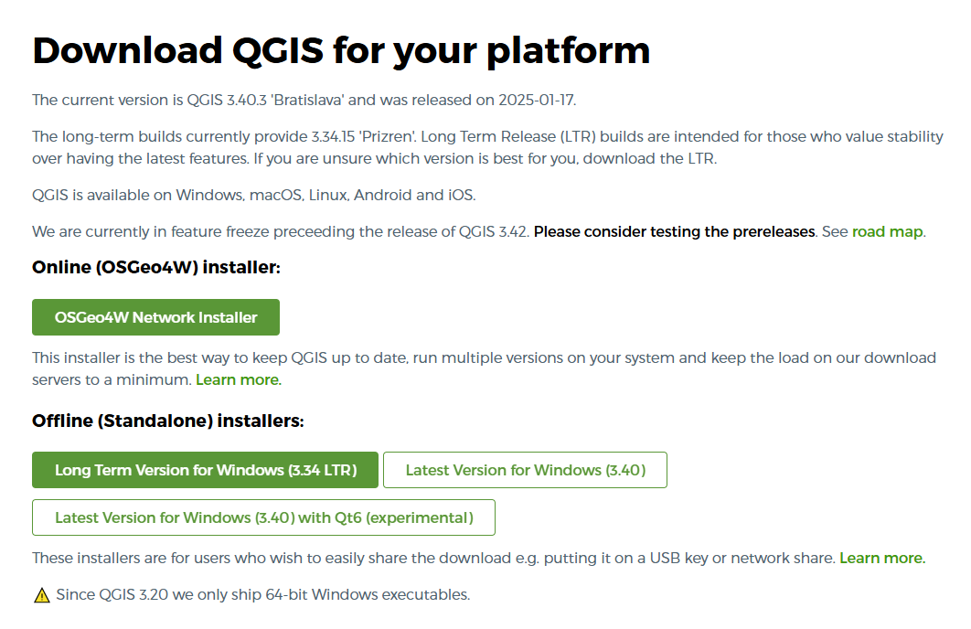
Installation of QGIS
QGIS downloads can be accessed from https://qgis.org/download/
Download the appropriate version for your operating system.

Slide 6
Installation of QGIS
QGIS downloads can be accessed from https://qgis.org/download/
Download the appropriate version for your operating system or select Online Installer.

Slide 7
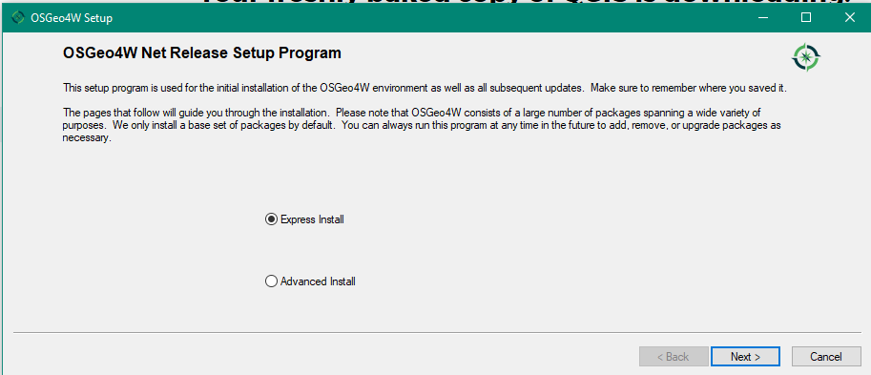
Installation of QGIS
In the installation window, select Express Install.
Click Next.

Slide 8
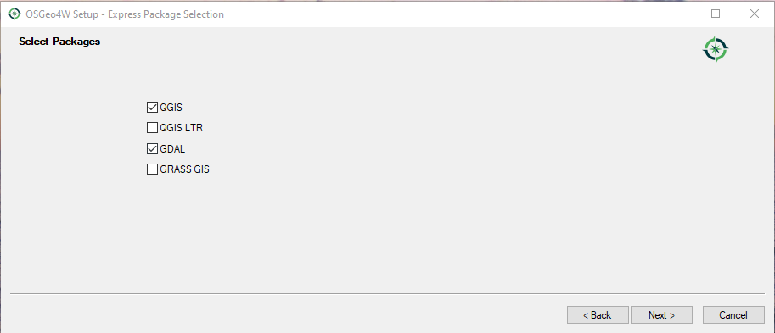
Installation of QGIS
Select QGIS and GDAL

Slide 9
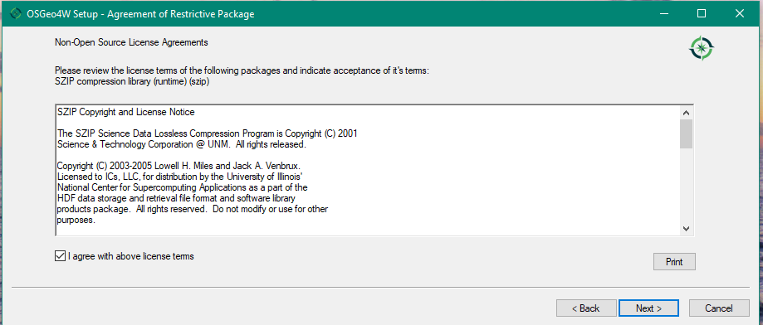
Installation of QGIS
Read and agree with the license terms.
Click Next.

Slide 10
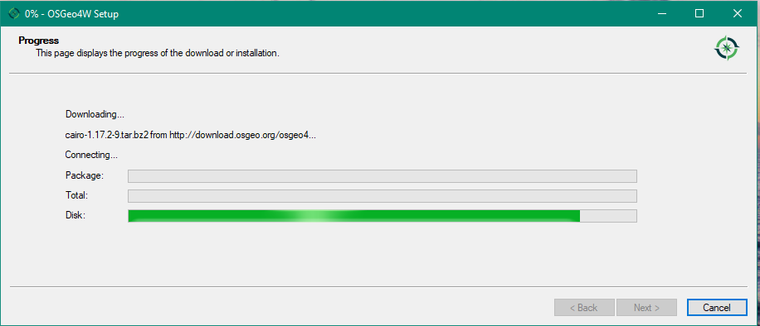
Installation of QGIS
The installation will begin.
When it is finished, click Next.

Slide 11
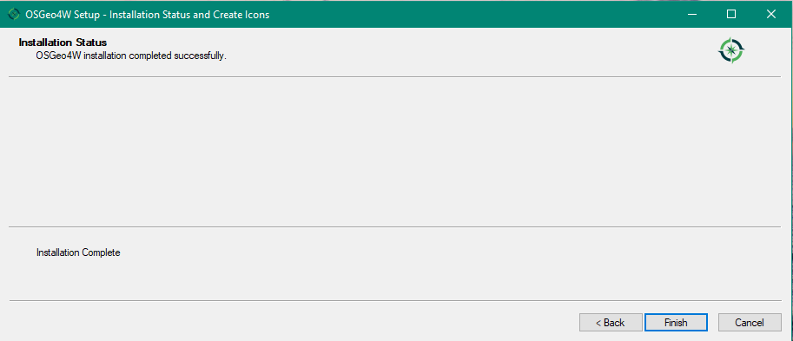
Installation of QGIS
Click Finished.

Slide 12
Accessing the project

Slide 13
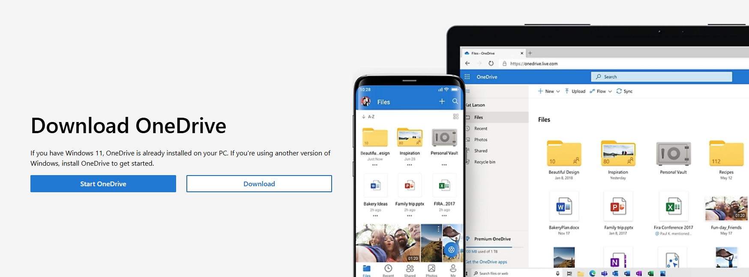
OneDrive
This project accesses GIS layers and QGIS project located on Microsoft SharePoint.
You will need to download and install Microsoft OneDrive on your computer.
https://www.microsoft.com/en-us/microsoft-365/onedrive/download

Slide 14
Creating a shortcut to the project

Slide 15
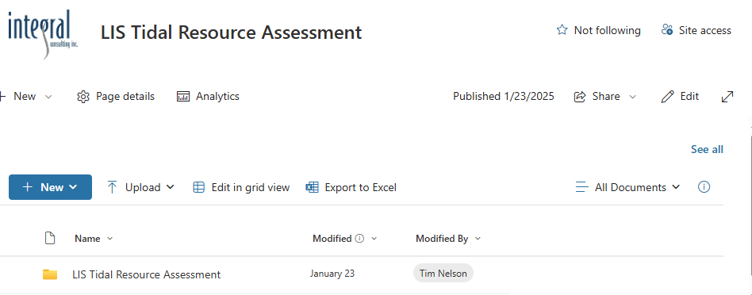
Accessing the Project
Navigate to https://icit.sharepoint.com/sites/C3962
Select “See all”

Slide 16
Accessing the Project
Select “Add shortcut to OneDrive” in the toolbar.
This will add a shared folder to your main OneDrive folder.
*if shortcut button is not an option, see alternative on next slide

Slide 17
Alternative Download
If the shortcut button was not an option, download the package .zip file to your local computer.
Select the … next to the zip file. Select Download.

Slide 18
Alternative Download
Extract the download zip file to a directory on your computer.
For consistency with the tutorial, it is recommended you name the folder
Shared Documents - LIS Tidal Resource Assessment
Note: The downloaded file will not be updated when changes are made to the SharePoint directory. You will need to redownload and replace the directory on your computer.

Slide 19
Opening the project in QGIS

Slide 20
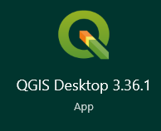
Open the Project
Navigate to and open QGIS on your computer.

Slide 21
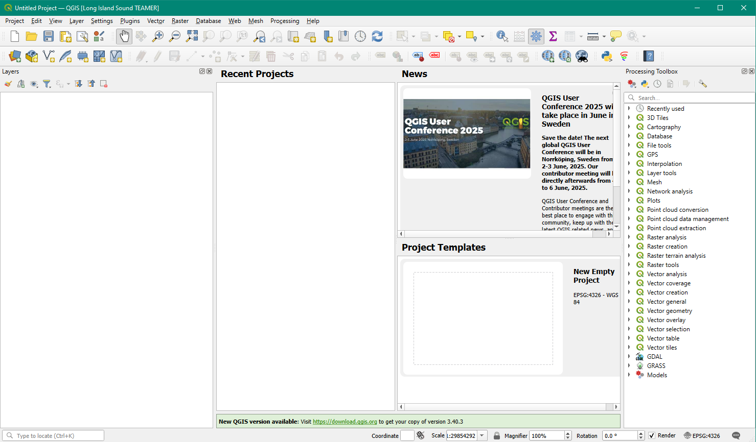
Open the Project
QGIS GUI will appear.
Click on the Open Icon in the toolbar

Slide 22
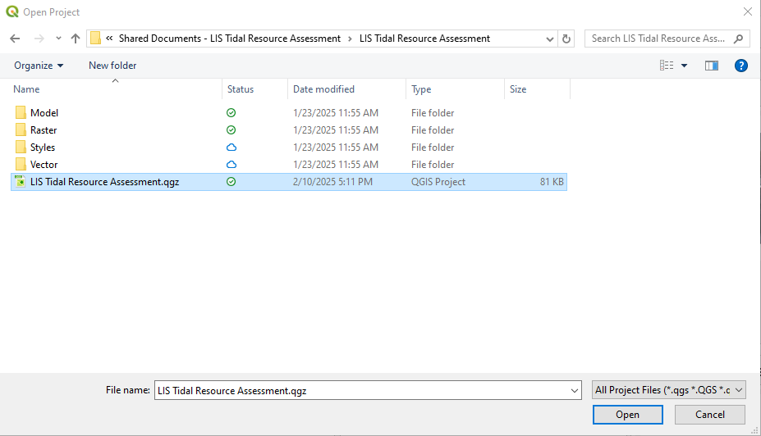
Open the Project
Navigate to LIS Tidal Resource Assessment.qgz
This will be in the shared OneDrive folder, likely
Shared Documents - LIS Tidal Resource Assessment\LIS Tidal Resource Assessment\LIS Tidal Resource Assessment.qgz

Slide 23
Open the Project
QGIS will load the project.
The layers available for this project are shown in the Layers panel on the left side of the page.
The layers are loaded under the group “Input Datasets”
These are further grouped by type of layer and model inputs.

Slide 24
Input Datasets

Slide 25
Viewing the Input Layers
Groups can be expanded by clicking the arrow next to the group name.
The input layers can be viewed by checking the box next to the group and individual layer.
To view layer style details such as color values, expand the layer by clicking the arrow next to the layer name.

Slide 26
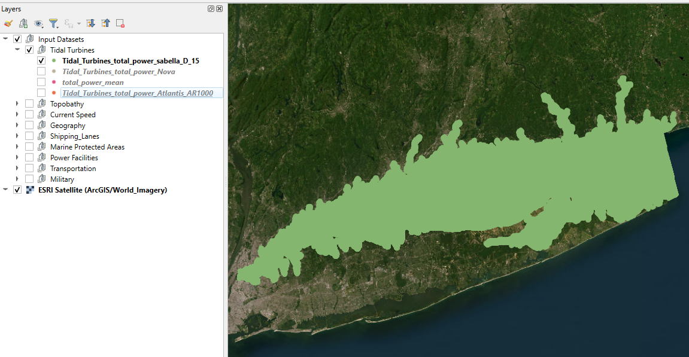
Input Datasets - Tidal Turbines
Energy production from 3 different tidal turbines as well as the total mean power are shown as point layers in the group Tidal Turbines.
These are used to determine the AEP.
The 4 turbines shown are:
Sabella D15
Nova
Atlantis AR1000

Slide 27
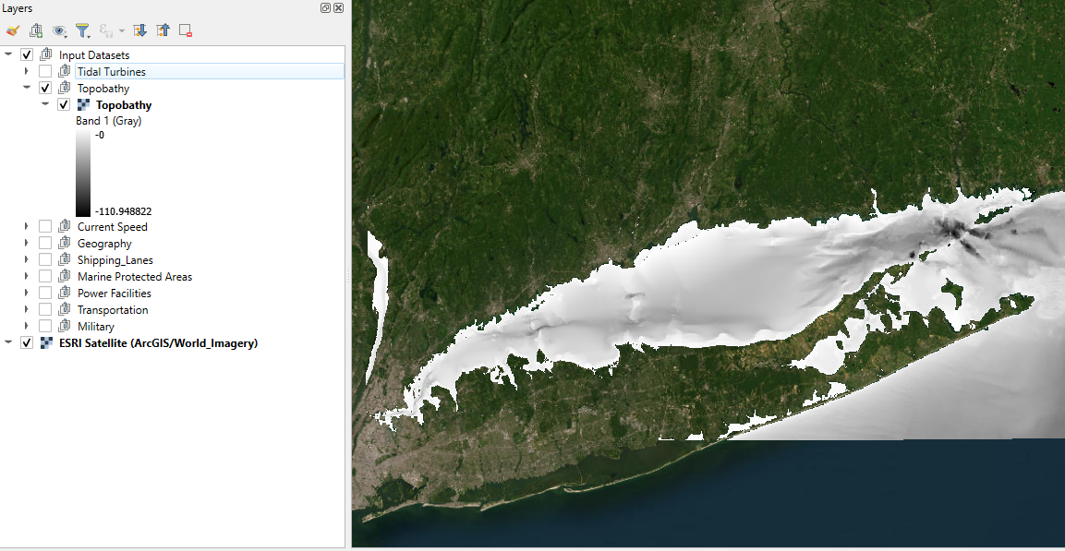
Input Datasets - Topobathy
The topobathy shows the elevation of the seabed (negative values below sea level)
This is used to determine physical limitations of tidal turbines and/or infrastructure.

Slide 28
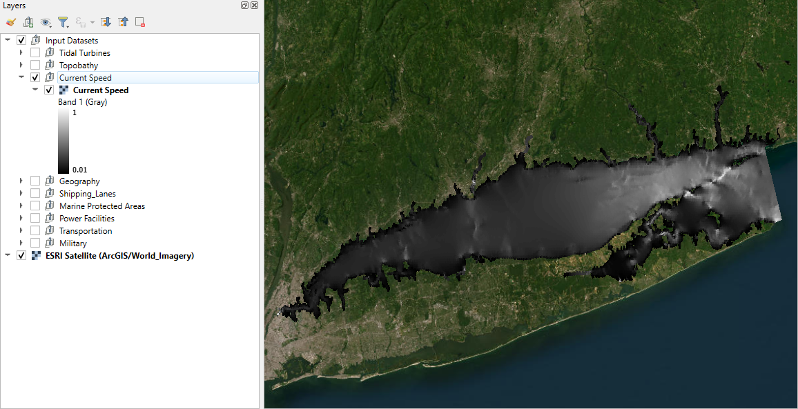
Input Datasets – Current Speed
The current speed layer shows the average tidal current speed.
This is used to determine physical limitations of tidal turbines and/or infrastructure.

Slide 29
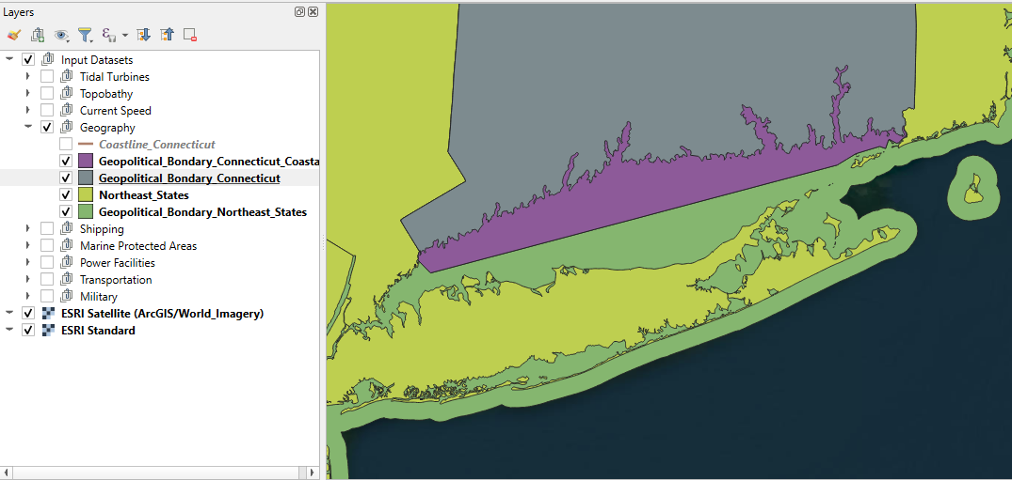
Input Datasets – Geography
The Geography defines boundaries used to limit the analysis
There are two types
The Coastline defines the boundary between the onshore and offshore infrastructure. This is used to determine cable run length.
Geopolitical defines the extent of possible onshore and offshore infrastructure.

Slide 30
Input Datasets – Shipping
The Shipping layer group defines restricted areas where turbine placement would be prohibited due to restricted navigation or existing shipping lanes.

Slide 31
Input Datasets – Marine Protected Areas
The Marine Protected Areas layer group defines restricted areas where species, habitat, or cultural areas would prohibit turbine placement.

Slide 32
Input Datasets – Power Facilities
The Power Facilities group layer indicates possible onshore connection locations which produce or transmit power, such as transmission substations, power plants, and offshore wind substations.

Slide 33
Input Datasets – Transportation
The Transportation layer group consists of Airports and Marine Transportation.
The Airports group consists of point layer indicating Public airports within Connecticut and a single point layer for Tweed-New Haven.
The Marine Transportation layer consists of a point layer with the location of port facilities.

Slide 34
Input Datasets – Military
The Military layer group consists of a point layer indicating the location of military bases within Connecticut.

Slide 35
LIS Tidal Resource Assessment Model Interface

Slide 36
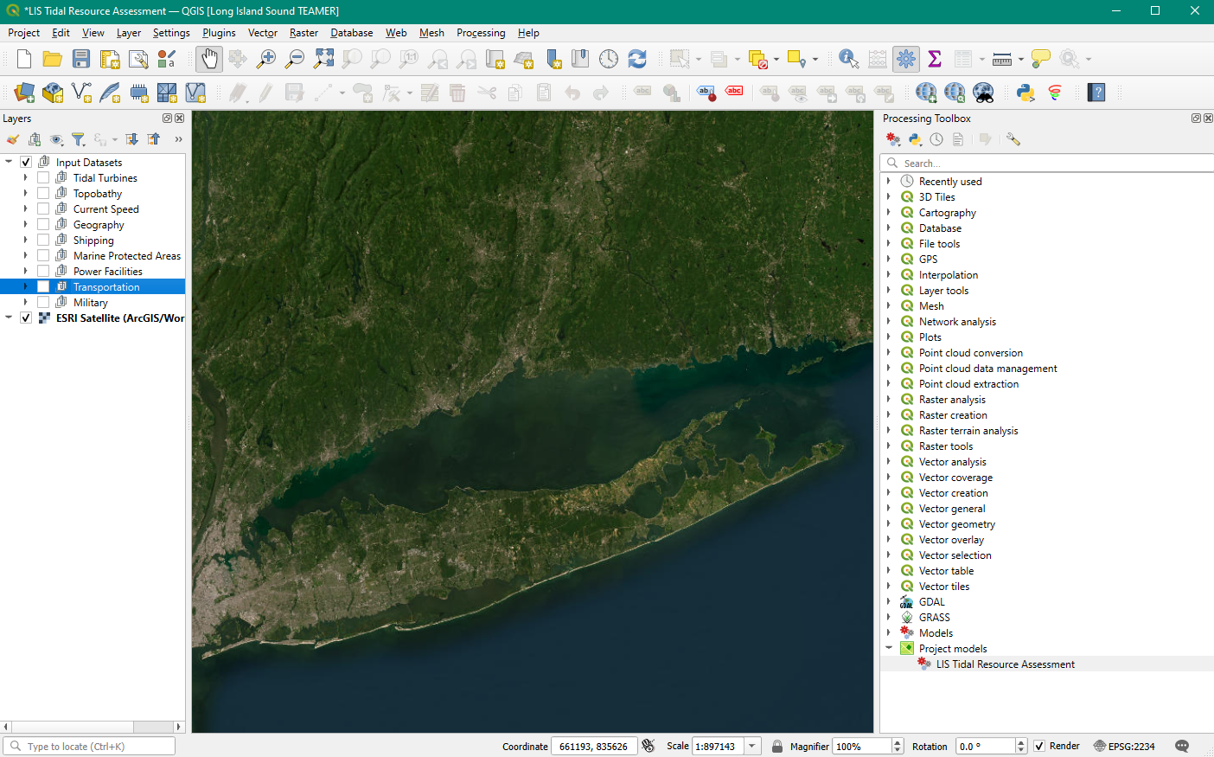
Model Interface
The LIS Tidal Resource Assessment model can be accessed in the Processing Toolbox on the right side of the QGIS workspace.
If the Processing Toolbox panel is not present, Click View → Panel → Processing Toolbox
Scroll to the bottom and expand Project models.
Double Click LIS Tidal Resource Assessment.

Slide 37
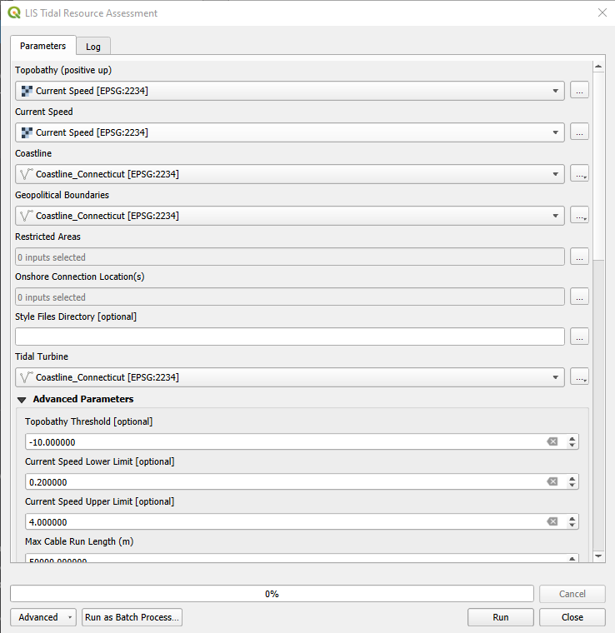
Model Interface
This opens the LIS Tidal Resource Assessment model input.
Here you can select the input files for analysis, choose outputs files to save, and add advanced options.
For simplicity, the input layers previously described have a prefix corresponding to the model input.
QGIS auto populates some fields, which are not always the correct field and will need to be changed.

Slide 38
Model Interface - Topobathy
To select the topobathy layer, click the dropdown arrow in the menu under the label Topobathy (positive up).
In the dropdown menu, select Topobathy.
QGIS shows all compatible layer types. In this case rasters. This does not indicate that these are all topobathy layers.

Slide 39
Model Interface– Current Speed
To select the current speed layer, click the dropdown arrow in the menu under the label Current Speed.
In the dropdown menu, select Current Speed.

Slide 40
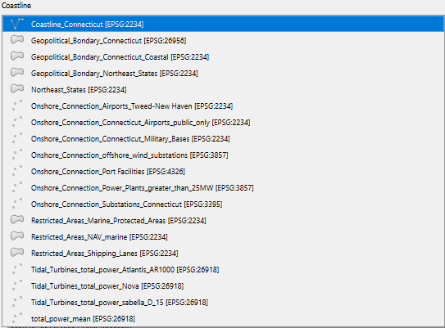
Model Interface – Coastline
To select the coastline layer, click the dropdown arrow in the menu under the label Coastline.
In the dropdown menu, select a Coastline layer.
To assist the user, the layer names have prefixes with the corresponding input options.

Slide 41
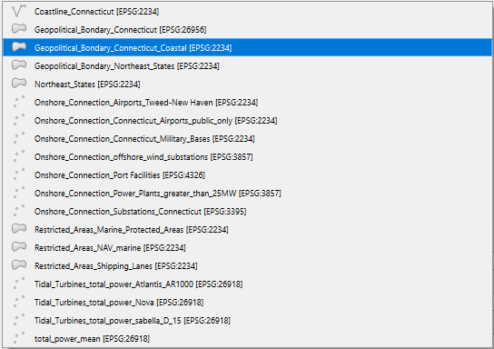
Model Interface – Geopolitical Boundaries
To select the geopolitical extents, click the dropdown arrow in the menu under the label Geopolitical Boundaries.
In the dropdown menu, select a Geopolitical layer.
The optional layers will have a prefix Geopolitical_Boundary.

Slide 42
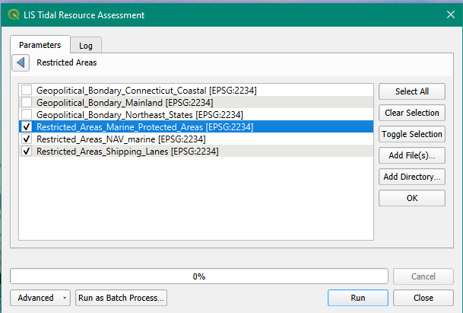
Model Interface – Restricted Areas
The user can select multiple Restricted Areas. To do this, click the … icon to the right of the Restricted Areas input.
This opens a new window.
Check the layers to be included in the analysis.
The optional layers will have a prefix Restricted_Areas.
Click OK.

Slide 43
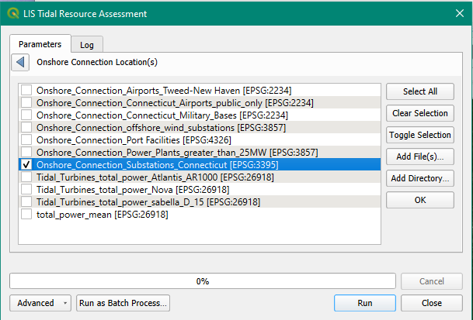
Model Interface – Onshore Connection Locations
The user can select multiple onshore connection locations. To do this, click the … icon to the right of the Onshore Connection Location(s) input.
This opens a new window.
Check the layers to be included in the analysis.
The optional layers will have a prefix Onshore_Connection.
Click OK.

Slide 44
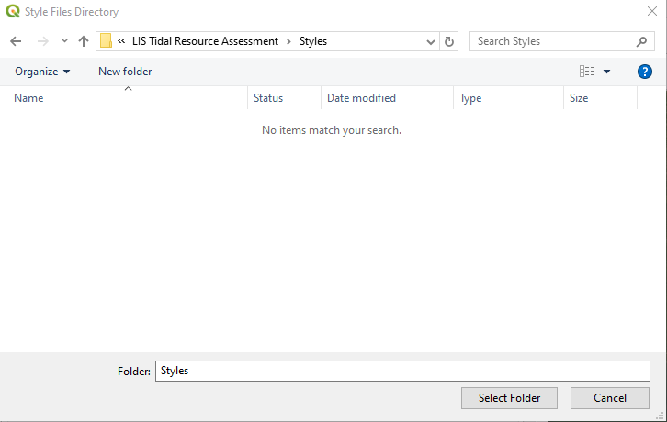
Model Interface – Styles Files Directory
Predefined layer styling such as color and colorbar min/max can be applied to the model output.
These inputs have a specific name and are placed in a single directory.
To apply these, select the … icon to the right of Style Files Directory.
Navigate to the folder.
LIS Tidal resource Assessment/Styles
Click Select Folder.

Slide 45
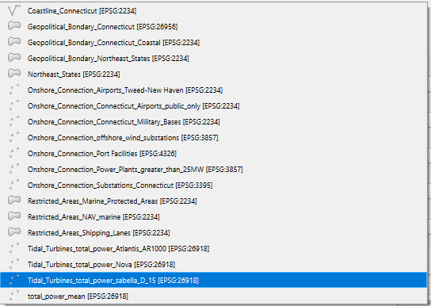
Model Interface – Tidal Turbine
To select the tidal turbine, click the dropdown arrow in the menu under the label Tidal Turbine.
In the dropdown menu, select a Tidal Turbine layer.
To assist the user, the layer names have prefixes with the corresponding input options.

Slide 46
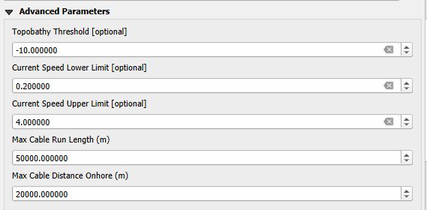
Model Interface – Advanced Parameters
There are several values that are not predefined by layers that the user can manually input in the Advanced Properties section.
If this section is not visible, click the arrow to expand the options.
The values shown to the right are the default values that load each time.

Slide 47
Model Interface – Advanced Parameters
Topobathy Threshold
The upper cutoff to look for suitable location. Only elevations below this value will be used.
units of topobathy raster
Current Speed
Lower Limit – exclude locations where the speed is slower than this value
Upper Limits – exclude locations where the speed is faster than this value.
units of current speed raster

Slide 48
Model Interface – Advanced Parameters
Max Cable Run Length (m)
The maximum straight-line distance the cable can run from an offshore turbine or substation to an onshore termination.
Must be in meters.
Maximum Cable Distance Onshore (m)
The maximum straight-line distance the cable can run from the coastline to an onshore termination.
Must be in meters

Slide 49
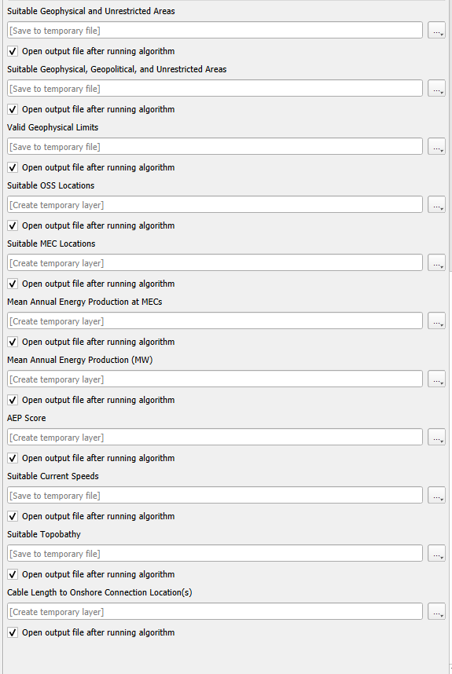
Model Interface – Saving Output Files
The use has the option to save the model output files, only display within QGIS temporarily, or not display a certain result.
The default setting is to create a temporary file that is removed when QGIS closes and to display all layers.

Slide 50
Model Interface – Saving Output Files
To unselect a layer for display, uncheck the arrow next to the box Open output file after running algorithm.

Slide 51
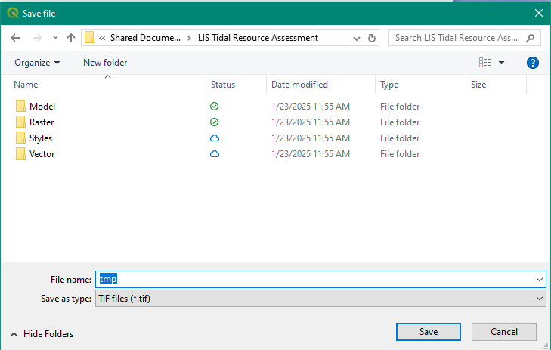
Model Interface – Saving Output Files
To save a file to disk, click the … icon to the right of the output layer, chose save to file.
Chose a folder and enter a filename.
Click Save.
Repeat for additional layers.
Some layers have different output options.

Slide 52
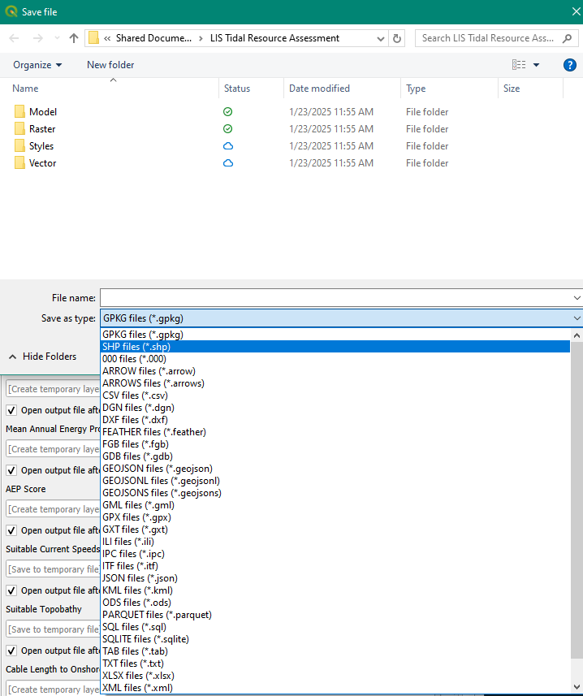
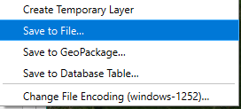
Model Interface – Saving Output Files
The previous example showed a raster output.
For certain layers you will see additional options.
Choose the file type you would like.

Slide 53
Running the Model

Slide 54
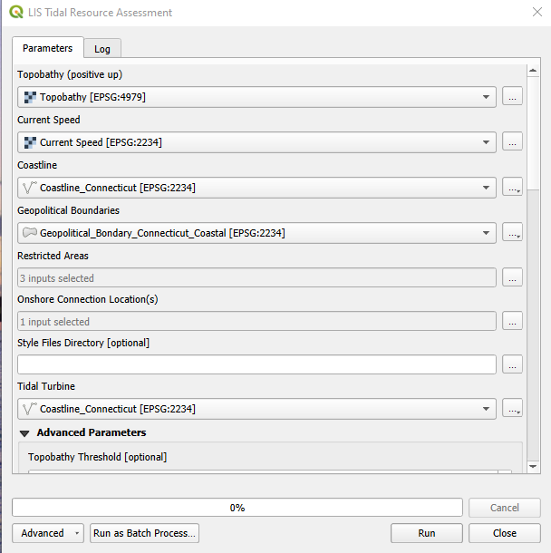
Running the Model– Saving Output Files
Once all the input and output options are selected, click Run.

Slide 55
Running the Model– Saving Output Files
The model will now run with a log of the processes running displayed in the log window.
Progress will be shown in the progress bar.
Once the model finishes running, click Close.

Slide 56
Output Datasets

Slide 57
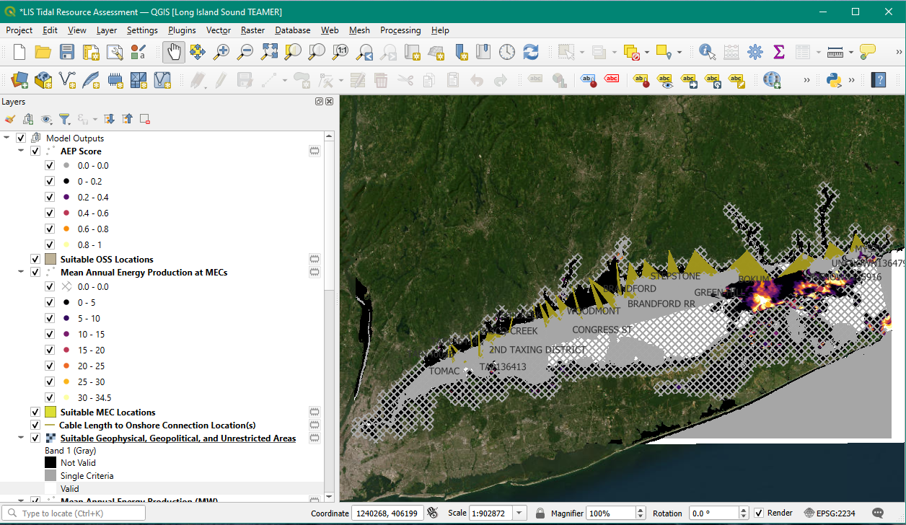
Model Outputs
The model output will be displayed within the QGIS map window.
The individual output layers are saved within the layer group Model Outputs
By default, all layers are selected. It is recommended to deselect all layers and evaluate them one at a time.

Slide 58
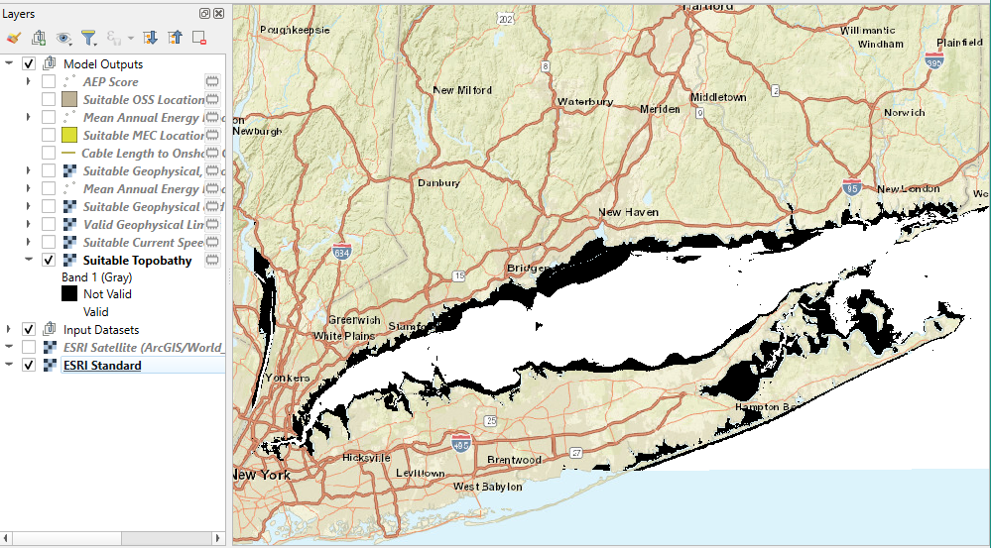
Model Outputs – Suitable Topobathy
The Suitable Topobathy layer defines the elevations that fall below the Topobathy Threshold defined in the advanced parameters.
This a binary raster where 0 indicates regions do not meet the topobathy requirements and 1 indicates regions where turbines meet the topobathy requirements.
The default style files, if selected, will set valid regions to white and invalid regions to black.

Slide 59
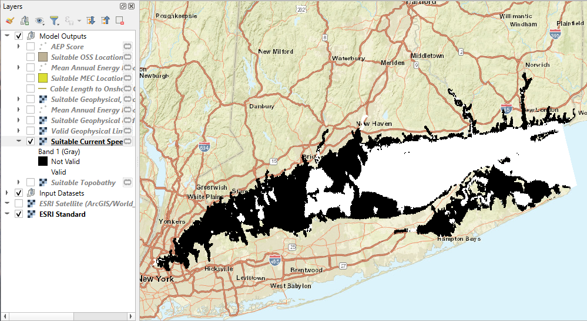
Model Outputs – Suitable Current Speed
The Suitable Current Speed layer defines the elevations that fall below the Current Speed Upper Threshold and above the Current Speed Lower Threshold defined in the advanced parameters.
This a binary raster where 0 indicates regions do not meet the current speed requirements and 1 indicates regions where current speed .
The default style files, if selected, will set valid regions to white and invalid regions to black.

Slide 60
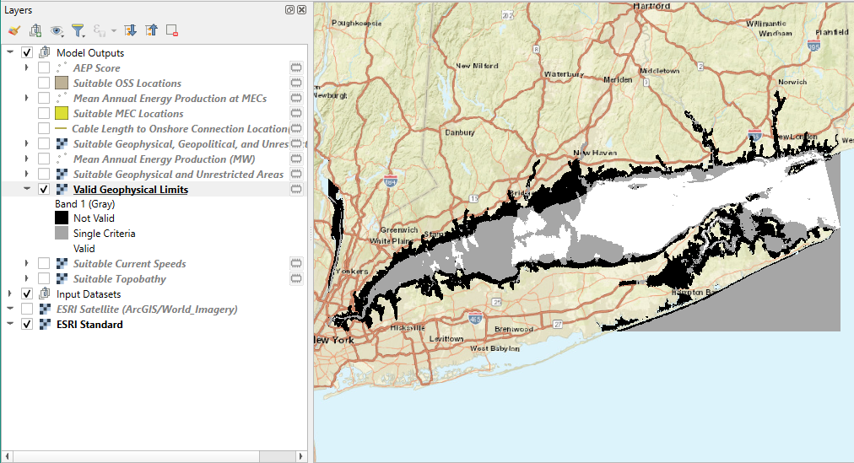
Model Outputs – Valid Geophysical Limits
The Valid Geophysical Limits layer defines the combined suitable topography and current speed layers.
This a classified raster where 0 indicates regions do not meet either requirements and 1 indicates regions where either current speed or topobathy meet criteria but not both, and 2 indicates regions where both criteria are met.
The default style files, if selected, will set valid regions to white, invalid regions to black, and gray when only one layer meets the requirements.

Slide 61
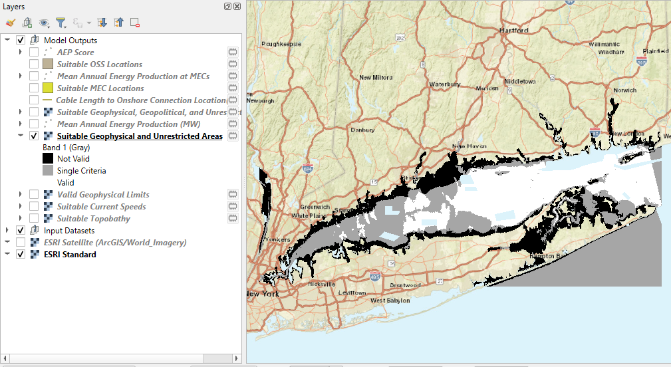
Model Outputs – Suitable Geophysical and Unrestricted Areas
The Suitable Geophysical and Unrestricted Areas removes restricted areas from the valid geophysical limits.
This a classified raster where 0 indicates regions do not meet either requirements and 1 indicates regions where either current speed or topobathy meet criteria but not both, and 2 indicates regions where both criteria are met. Gaps indicate regions that are restricted.
The default style files, if selected, will set valid regions to white, invalid regions to black, and gray when only one layer meets the requirements.

Slide 62
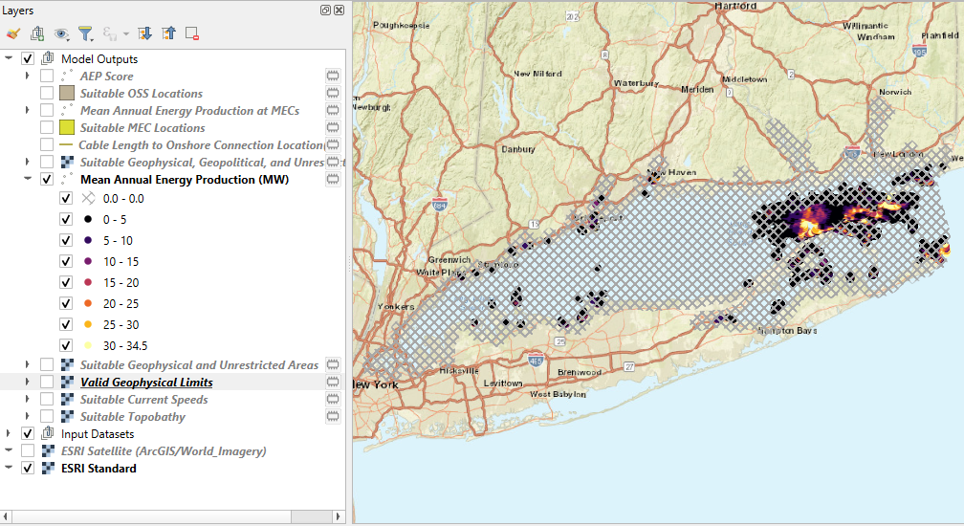
Model Outputs – Mean Annual Energy Production (MW)
The Mean Annual Energy Production (MW) layer calculates the mean annual energy production from the input turbine layer.
This a point layer where the field AEP indicates the AEP in Megawatts for each point. This is for all turbine points and not filtered by valid locations.
The default style files, if selected, will create a graduated color ramp ranging from 0 to 34.5 MW. Values with 0 MW are set to crosshatches.

Slide 63
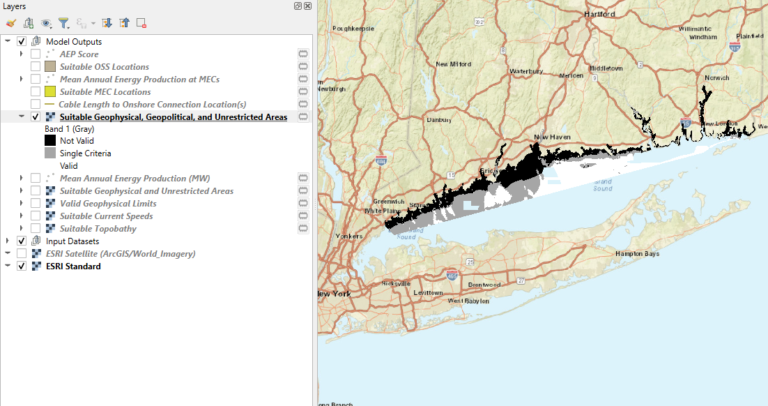
Model Outputs – Suitable Geophysical, Geopolitical, and Unrestricted Areas
The Suitable Geophysical, Geopolitical, and Unrestricted Areas layer crops the Suitable Geophysical and Unrestricted Areas layer to only the area specified by the geopolitical boundary
This a classified raster where 0 indicates regions do not meet either requirements and 1 indicates regions where either current speed or topobathy meet criteria but not both, and 2 indicates regions where both criteria are met. Gaps indicate regions that are restricted or outside the political boundary.
The default style files, if selected, will set valid regions to white, invalid regions to black, and gray when only one layer meets the requirements.

Slide 64
Model Outputs – Cable Length to Onshore Connection Location(s)
The Cable Length to Onshore Connection Location(s) is a line layer file that shows the shortest straight-line distance between each AEP point and an onshore termination. The length and location is limited by the Max Cable Run Length (m) and Maximum Cable Distance Onshore (m) advanced user inputs.

Slide 65
Model Outputs – Suitable MEC Locations
The Suitable MEC Locations is a polygon layer that shows areas marine energy converters (MECs, e.g.: tidal turbines) can be placed that satisfy the selection criterion in Suitable Geophysical, Geopolitical, and Unrestricted Areas. The locations are not limited by the cable run length as it assumes a the MEC could connect to an offshore substation before coming onshore.

Slide 66
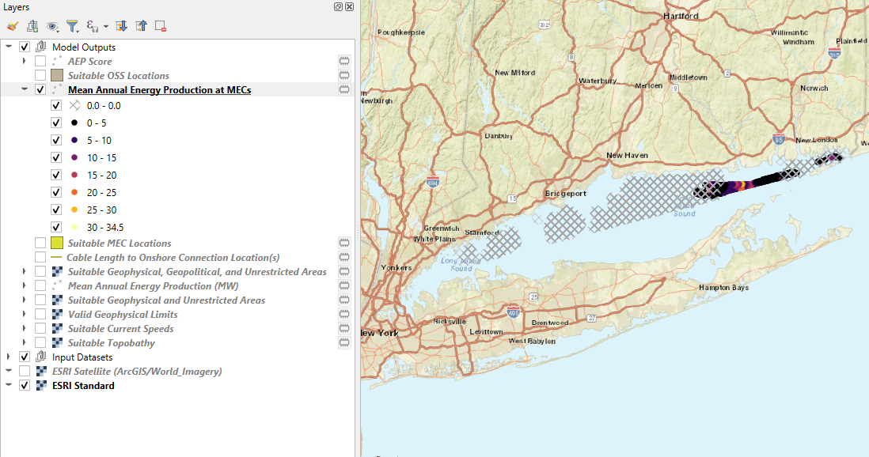
Model Outputs – Mean Annual Energy Production at MECs
The Mean Annual Energy Production at MECs layer calculates is the Mean Annual Energy Production (MW) layer clipped to the Suitable MEC Locations polygon.
This a point layer where the field AEP indicates the AEP in Megawatts for each point.
The default style files, if selected, will create a graduated color ramp ranging from 0 to 34.5 MW. Values with 0 MW are set to crosshatches.

Slide 67
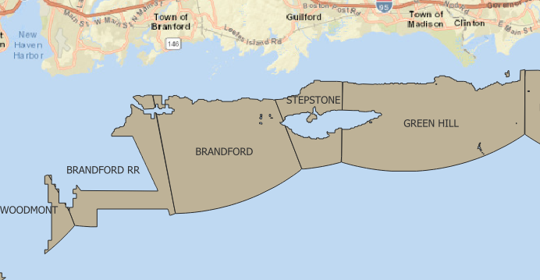
Model Outputs – Suitable OSS Locations
The Suitable OSS Locations is a polygon layer that shows areas marine energy converters or offshore sub stations (OSSs) can be placed that satisfy the selection criterion in Suitable Geophysical, Geopolitical, and Unrestricted Areas, Max Cable Run Length (m) and Maximum Cable Distance Onshore (m). Each polygon is labeled with the closest onshore termination location.

Slide 68
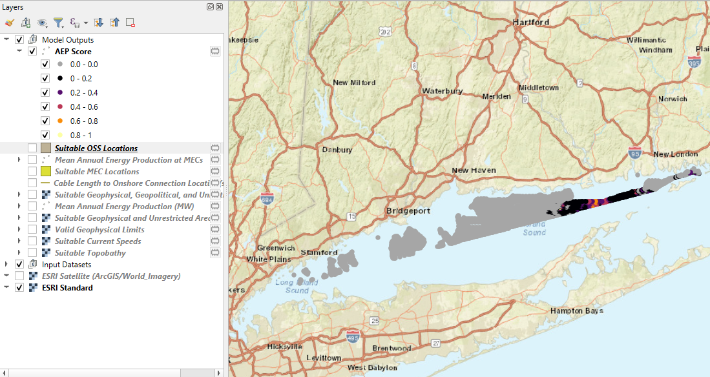
Model Outputs – AEP Score
The AEP Score layer scores the AEP based on energy production for the specified location and model inputs. This is defined as AEP/max(AEP), such that the with the most energy production is giving a value of 1.
This a point layer where the field AEP_Score is a unitless float value for each point.
The default style files, if selected, will create a graduated color ramp ranging from 0 to 1. Values of 0 are colored gray.

Slide 69
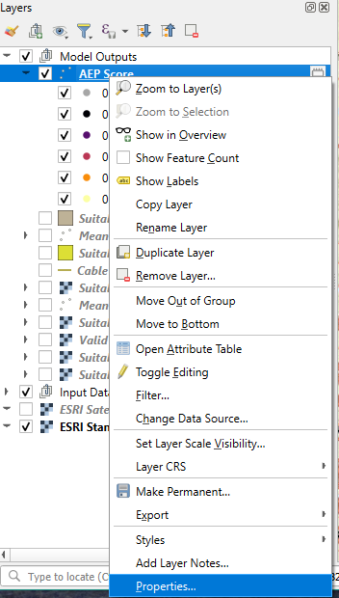
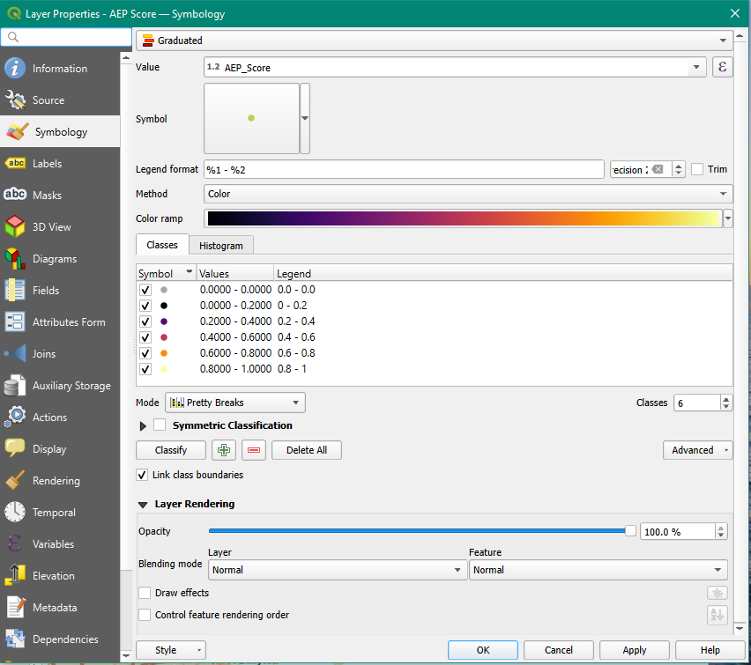
Changing the layer style
To change the layer style. Right click on the layer name.
Select Properties
This will open a dialogue where the color map, color ramp, and/or color can be changed.

Slide 70
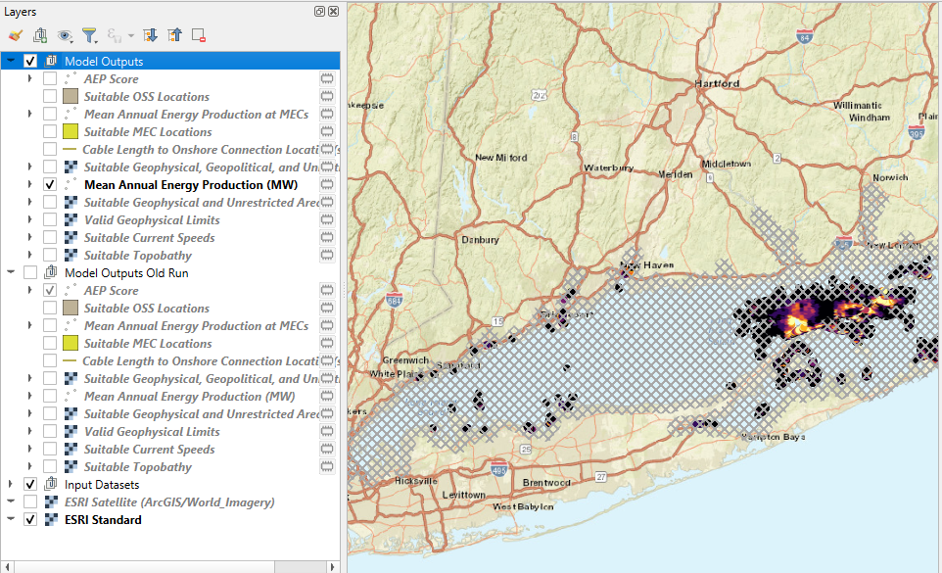
Running the Model Again
Multiple model results can be saved. However, they will always be generated in the Model Outputs group.
To keep the runs organized, rename the group before running the model again. The new model results will once again be in the group Model Outputs.

